Slide 1

Discrete Math Chapter 6
Graphs and Trees

Slide 2
Chapter 6 Overview
6-1 Graphs and Their Representations
6-2 Trees and Their Representations
6-3 Decision Trees (We will skip this chapter. It will be taught in algorithm and data structure.)
6-4 Huffman Encoding

Slide 3
Notes of Chapter 6
Graphs and Trees are one of the most important data structure in computer science. Many real-life applications are built with graphs and trees, such as DOM, abstract syntax tree, Binary Search Tree, and many others.
More algorithms and applications will be taught in chapter 7 and algorithm and data structure class. In chapter 6, we will focus on the terminologies and definitions.

Slide 4

6-1 Graphs and Their Representation

Slide 5
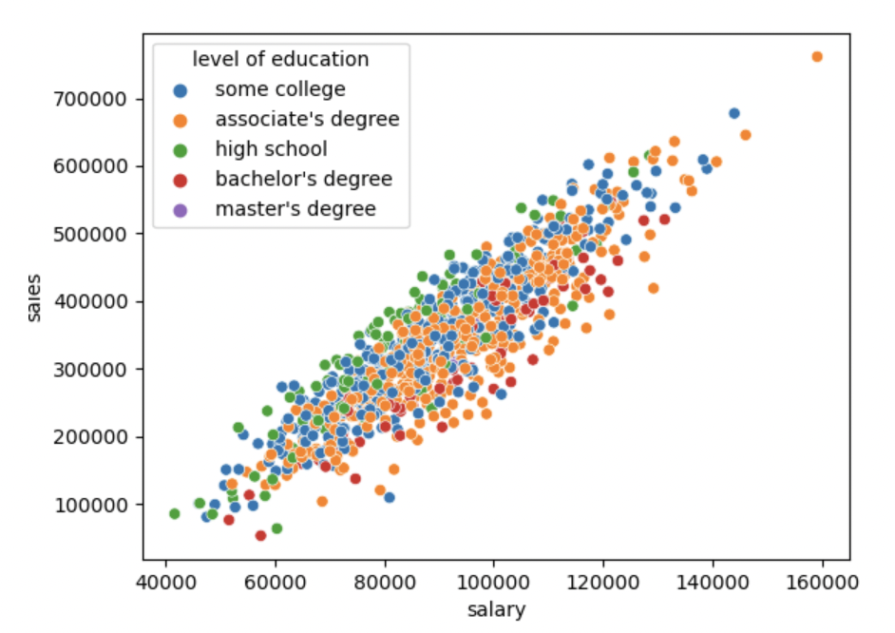
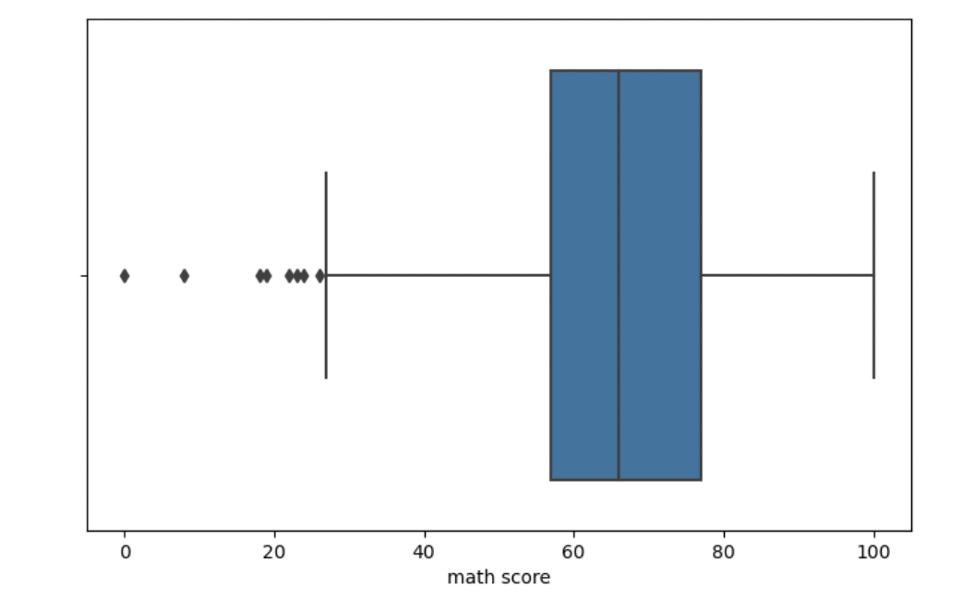
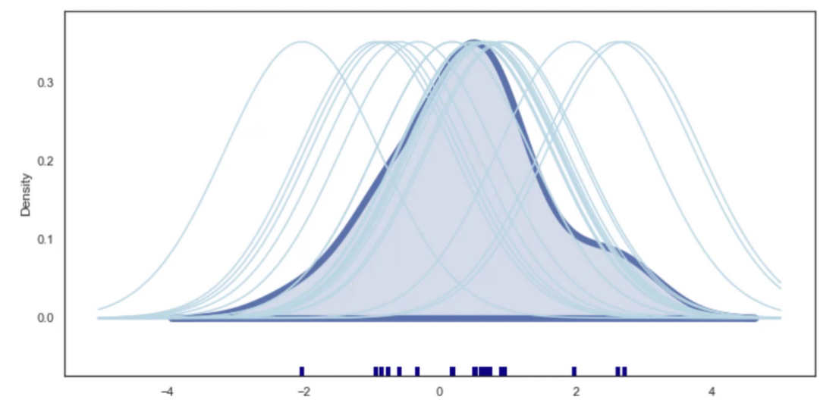
Graphs
In mathematics and statistics, there are tons of different graphs, such as scatterplot, displot, boxplot, and others.
However, in discrete math, we don’t care about any one them; instead, we only learn one type of graph (which is a data structure).

Slide 6
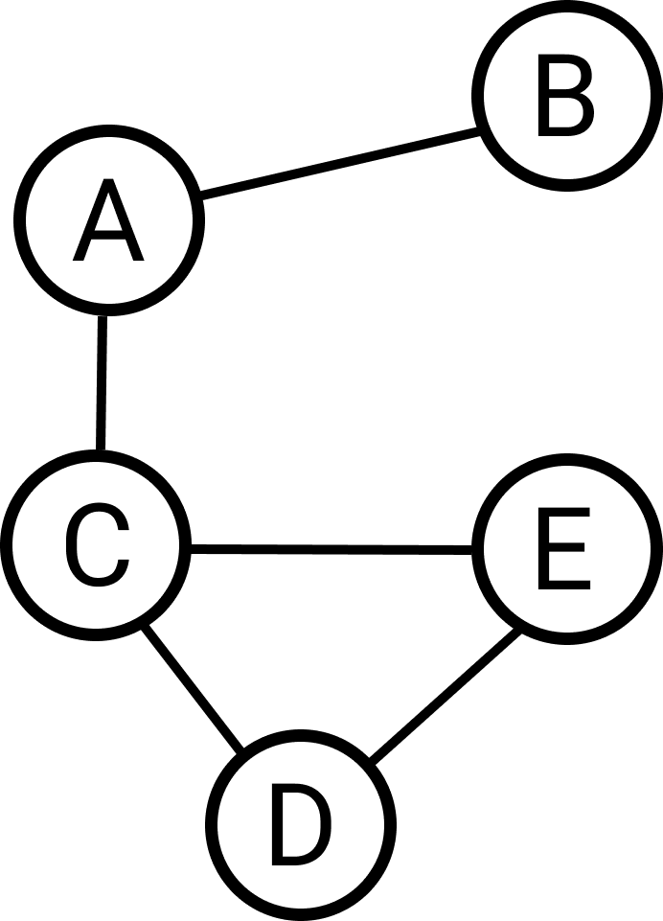
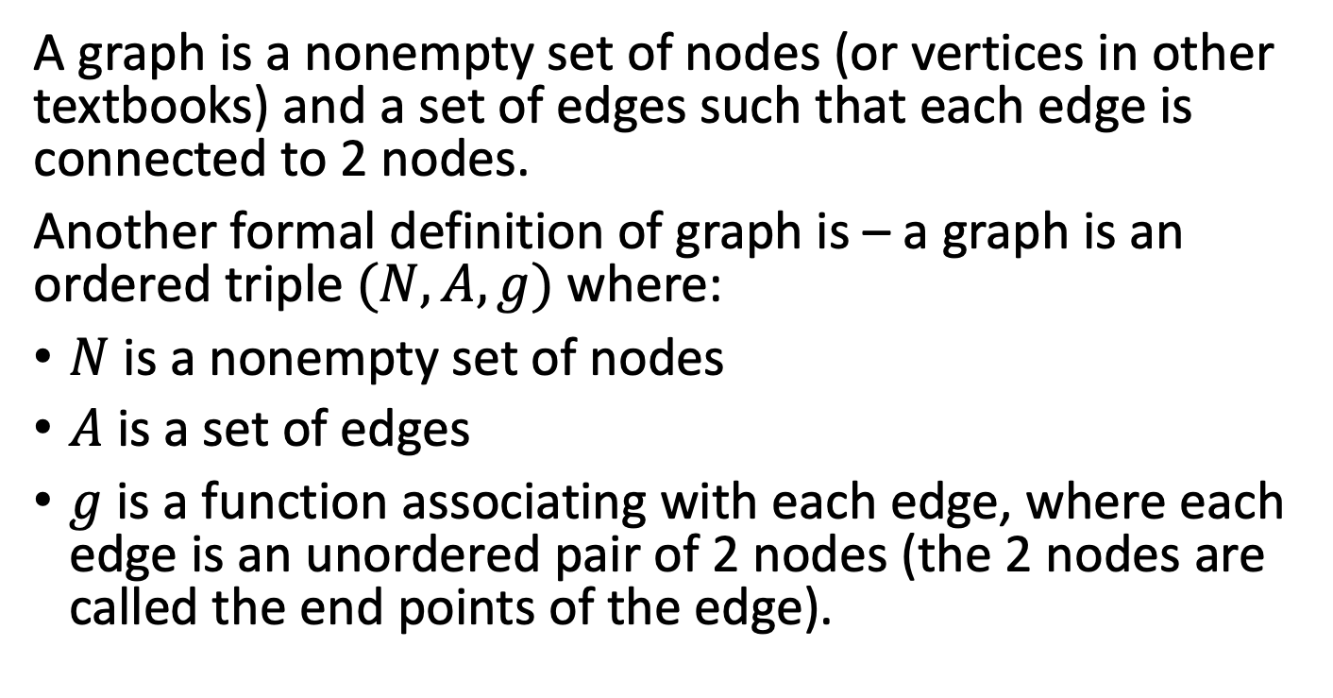
Graph
A graph is a nonempty set of nodes (or vertices in other textbooks) and a set of edges such that each edge is connected to 2 nodes.
Another formal definition of graph is – a graph is an ordered triple $(N, A, g)$ where:
$N$ is a nonempty set of nodes
$A$ is a set of edges
$g$ is a function associating with each edge, where each edge is an unordered pair of 2 nodes (the 2 nodes are called the end points of the edge).

Slide 7
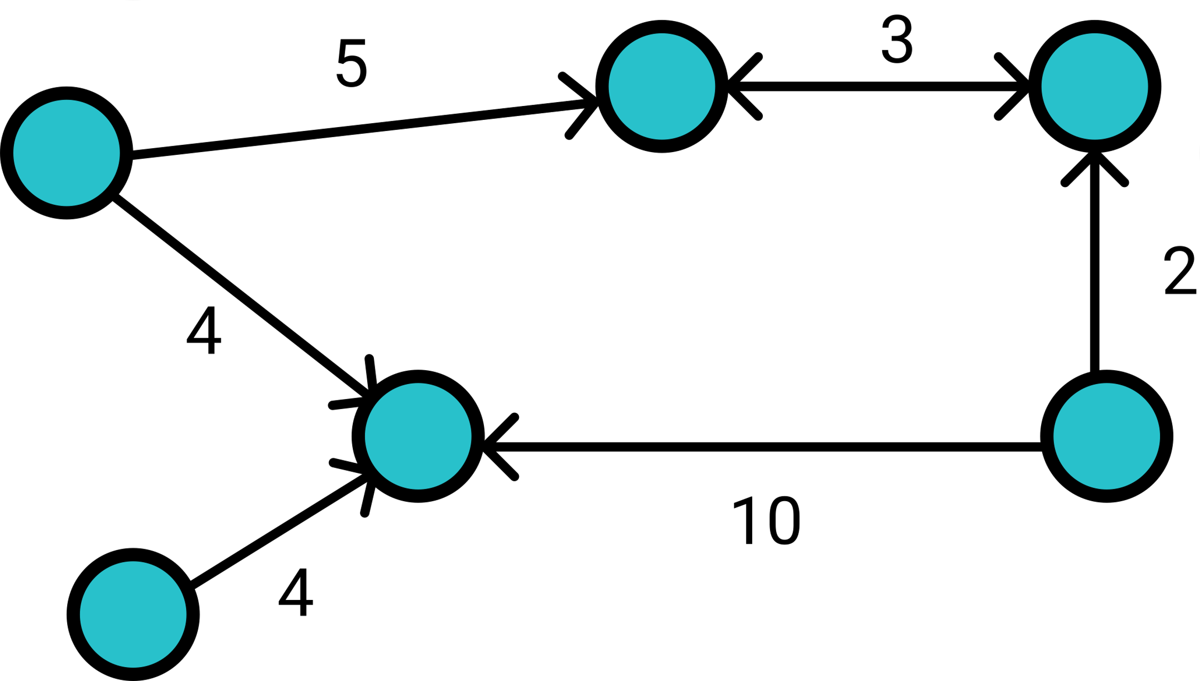
Directed Graph and Weighted Graph
A drected graph is a set of nodes connected by edges, where the edges have a direction associated with them.
A weighted graph is a set of nodes connected by edges, where the edges have a numerical weight associated with them.
A graph can be weighted and directed at the same time. For example, Google map is a directed weighted graph, since each road might have a direction and a length associated with it.
This is a weighted and directed graph.

Slide 8
Terminologies of Graph
Before we move on, let’s learn the terminologies used for graphs.
Adjacent – two nodes are adjacent if they are connected by an edge.
Loop - an edge that connects a vertex to itself.
Complete Grpah - a graph that all nodes are pairwise adjacent.
Subgraph of a Graph – a graph consists of a set of nodes and edges of the original Graph.
Cycle – a cycle in a graph is a non-empty trail in which the only repeated vertices are the first and last vertices.

Slide 9
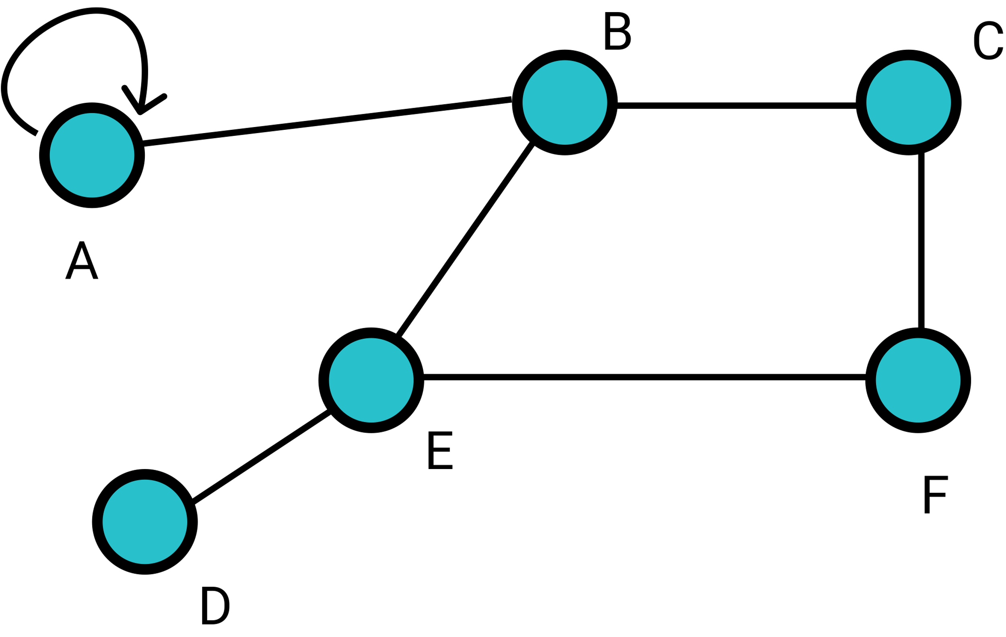
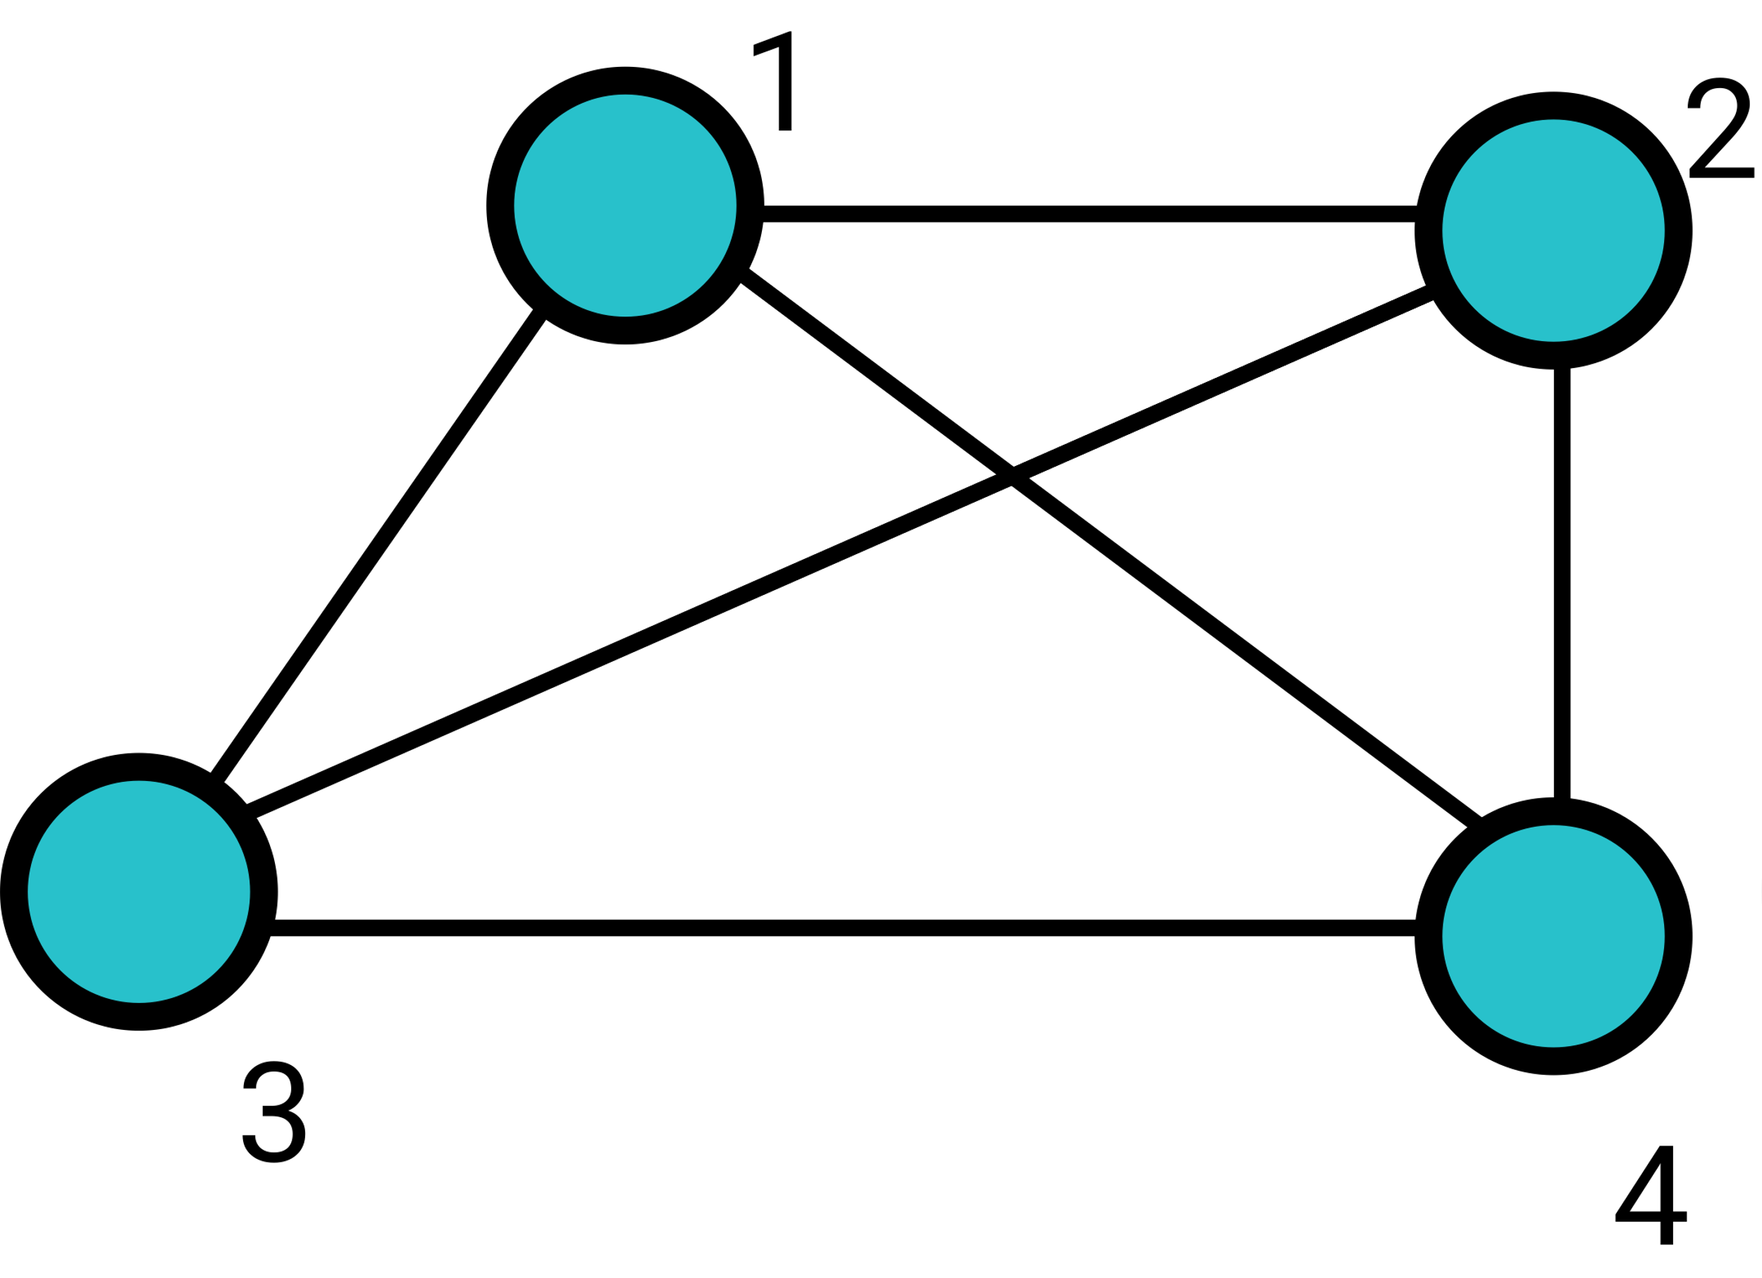
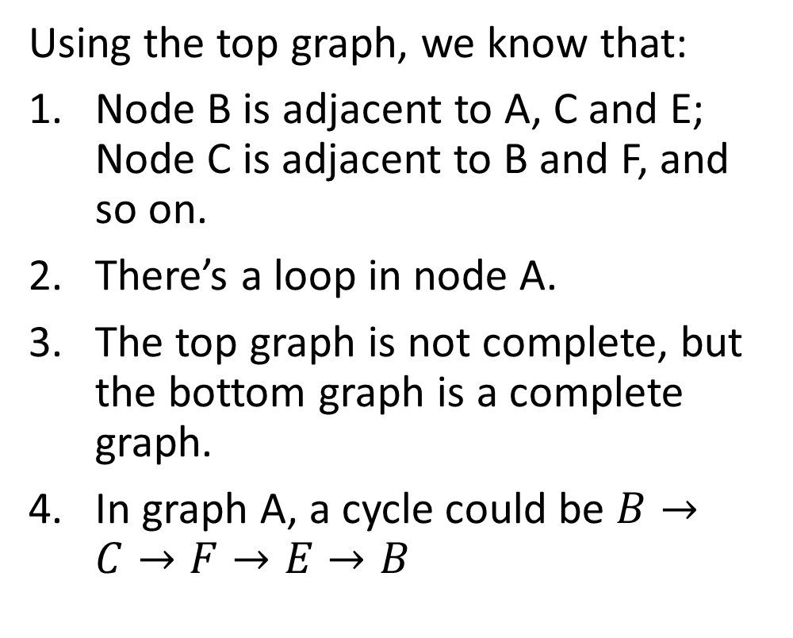
Terminologies of Graph
Using the top graph, we know that:
Node B is adjacent to A, C and E; Node C is adjacent to B and F, and so on.
There’s a loop in node A.
The top graph is not complete, but the bottom graph is a complete graph.
In graph A, a cycle could be $B→C→F→E→B$

Slide 10
Example 6-1-1
How many edges are there in a complete graph of 5 nodes? What about 100 nodes? What about n nodes?

Slide 11

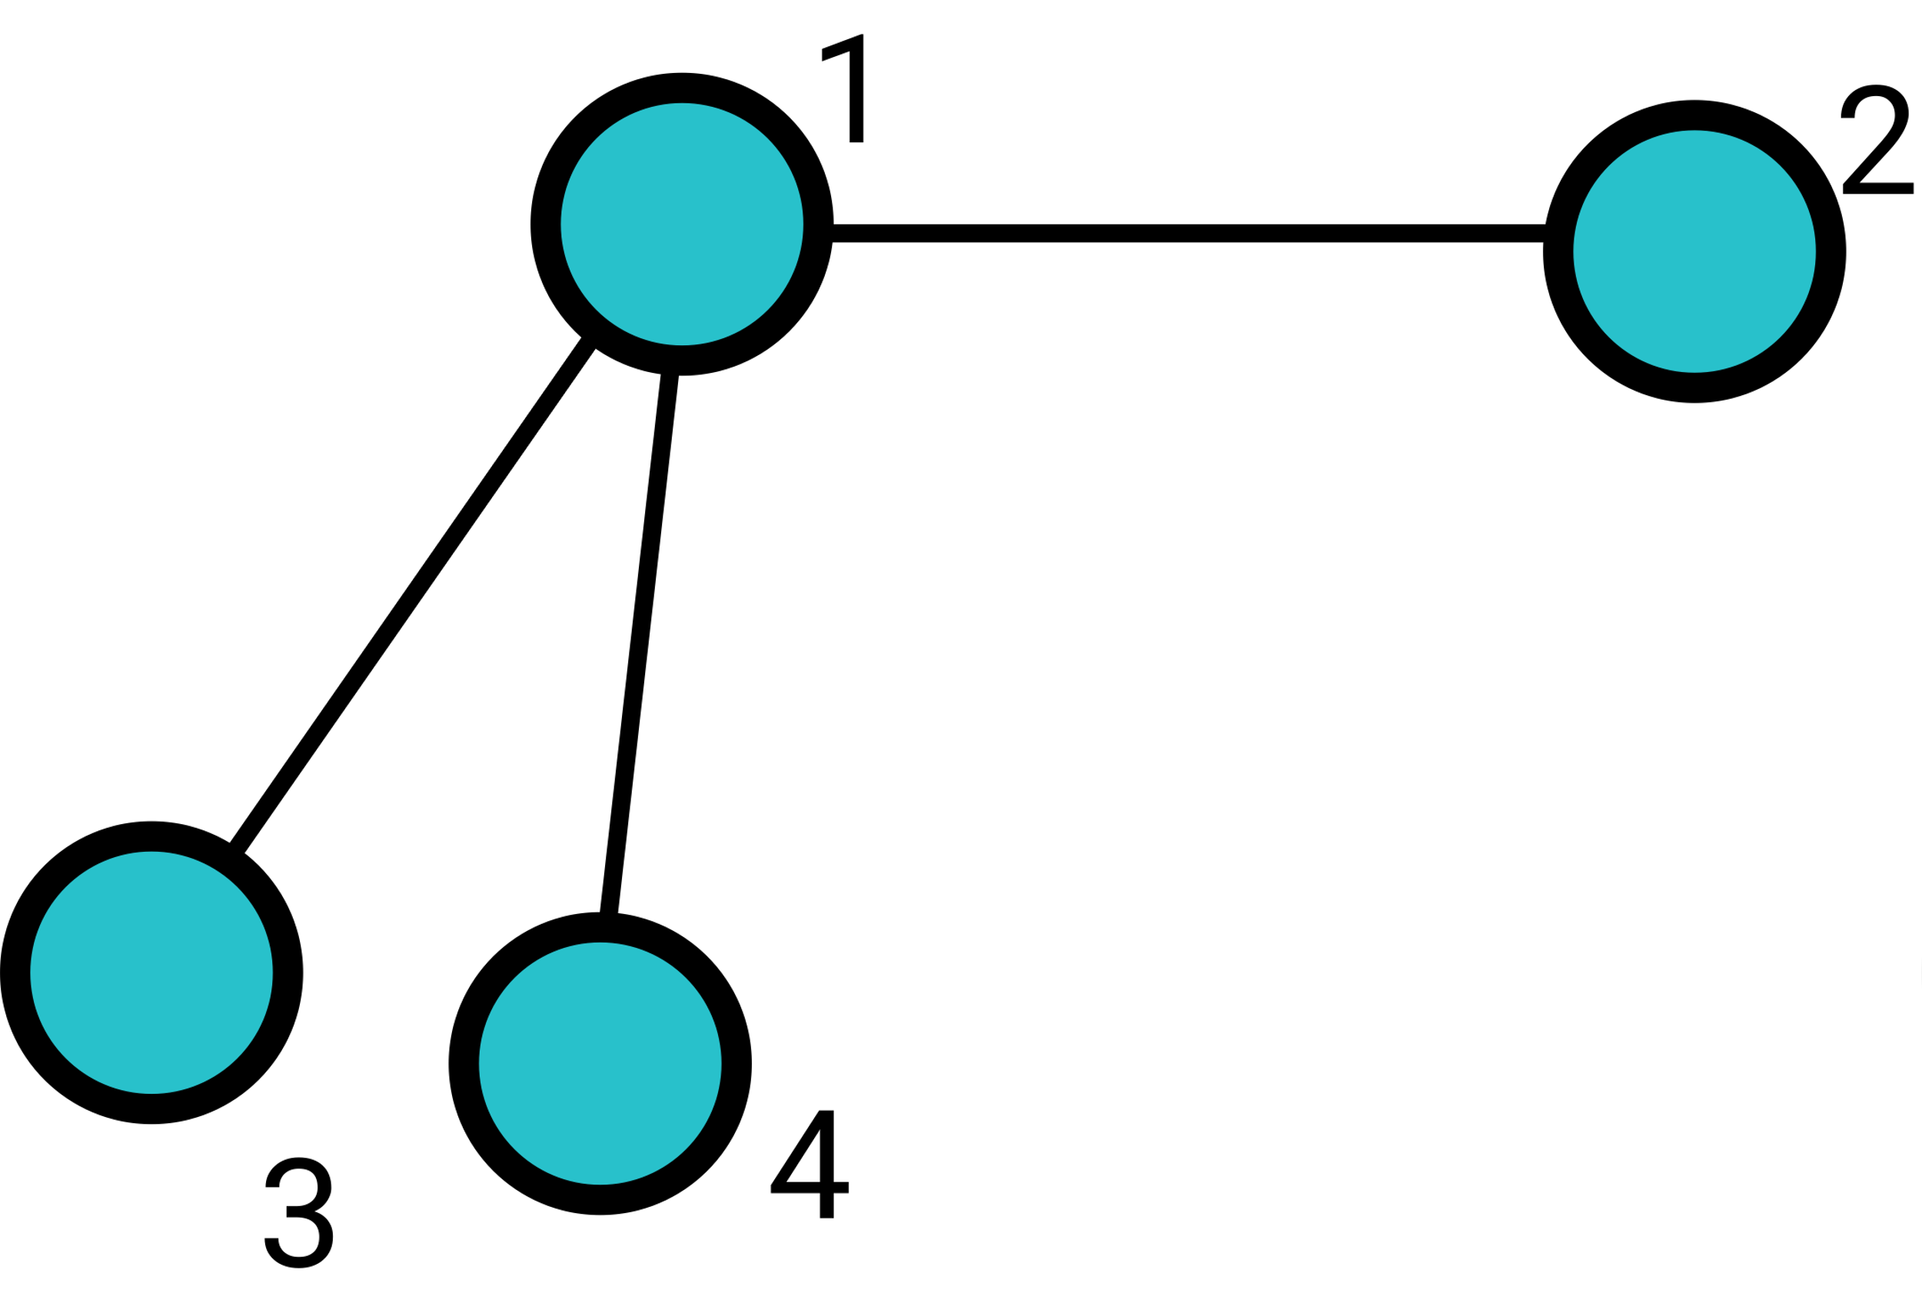
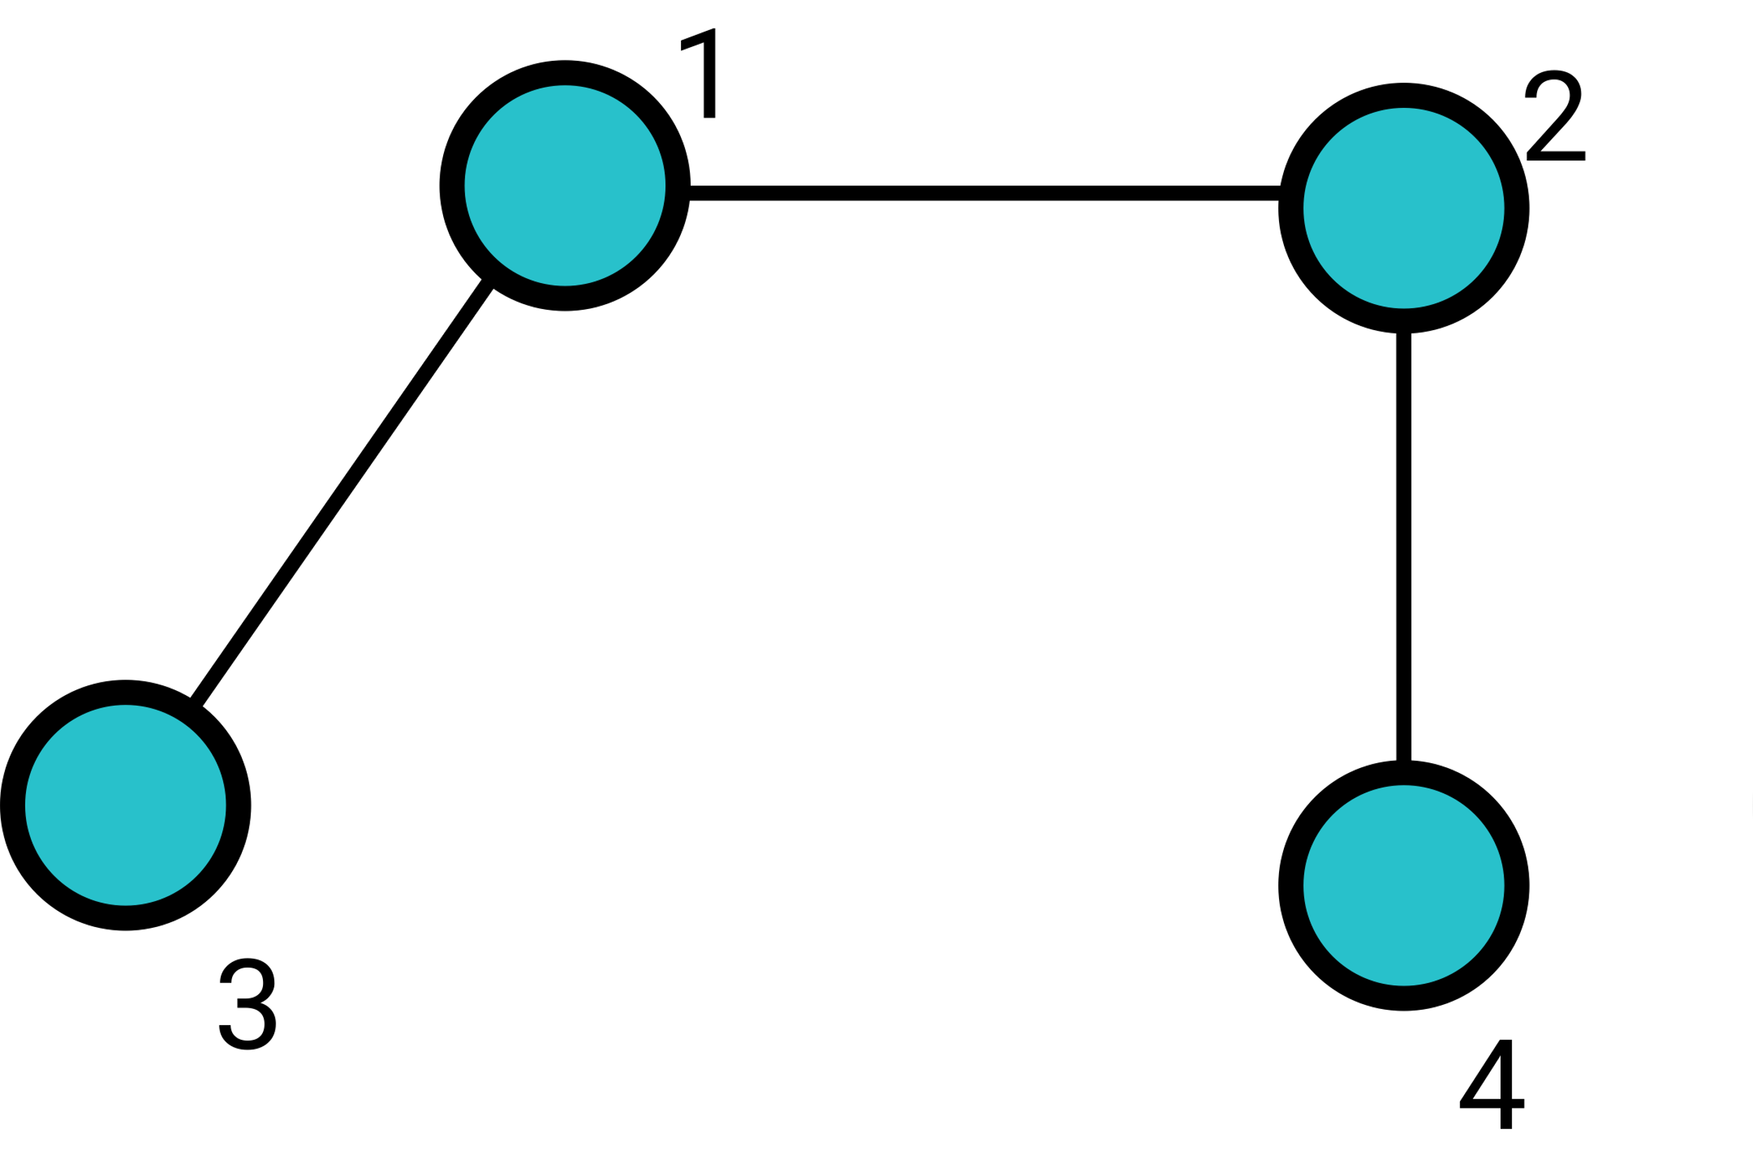
Isomorphism
Two graphs G1 and G2 are isomorphic if there exists a matching between their vertices so that two vertices are connected by an edge in G1 if and only if corresponding vertices are connected by an edge in G2.
For example, in the following graph 1, 2, and 3, 1 and 2 are isomorphic, but 3 is not isomorphic with 1 or 2.

Slide 12
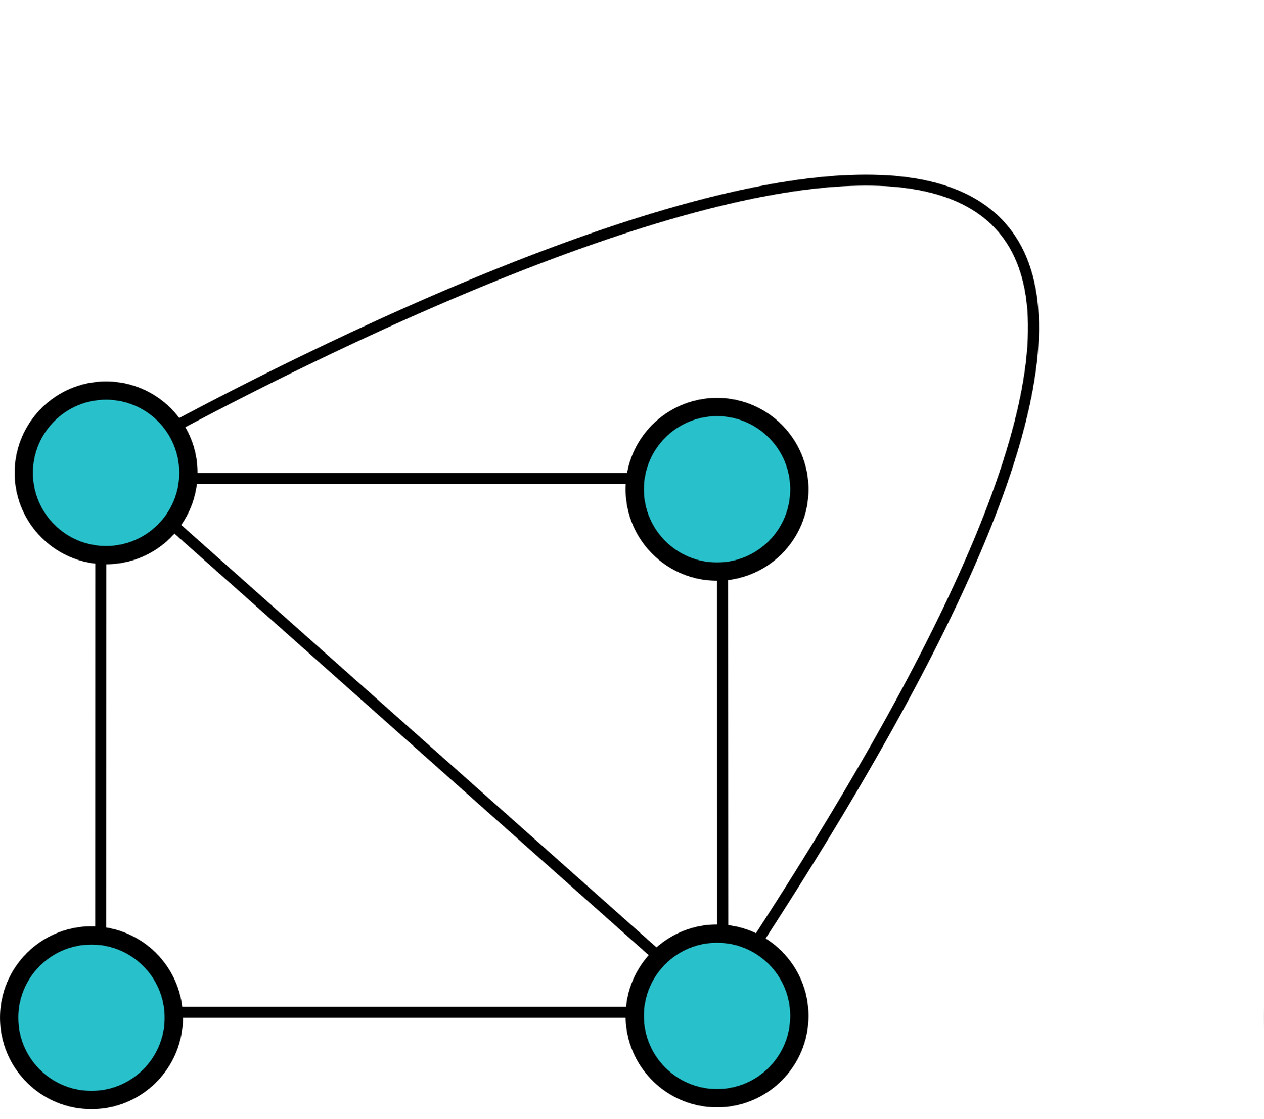
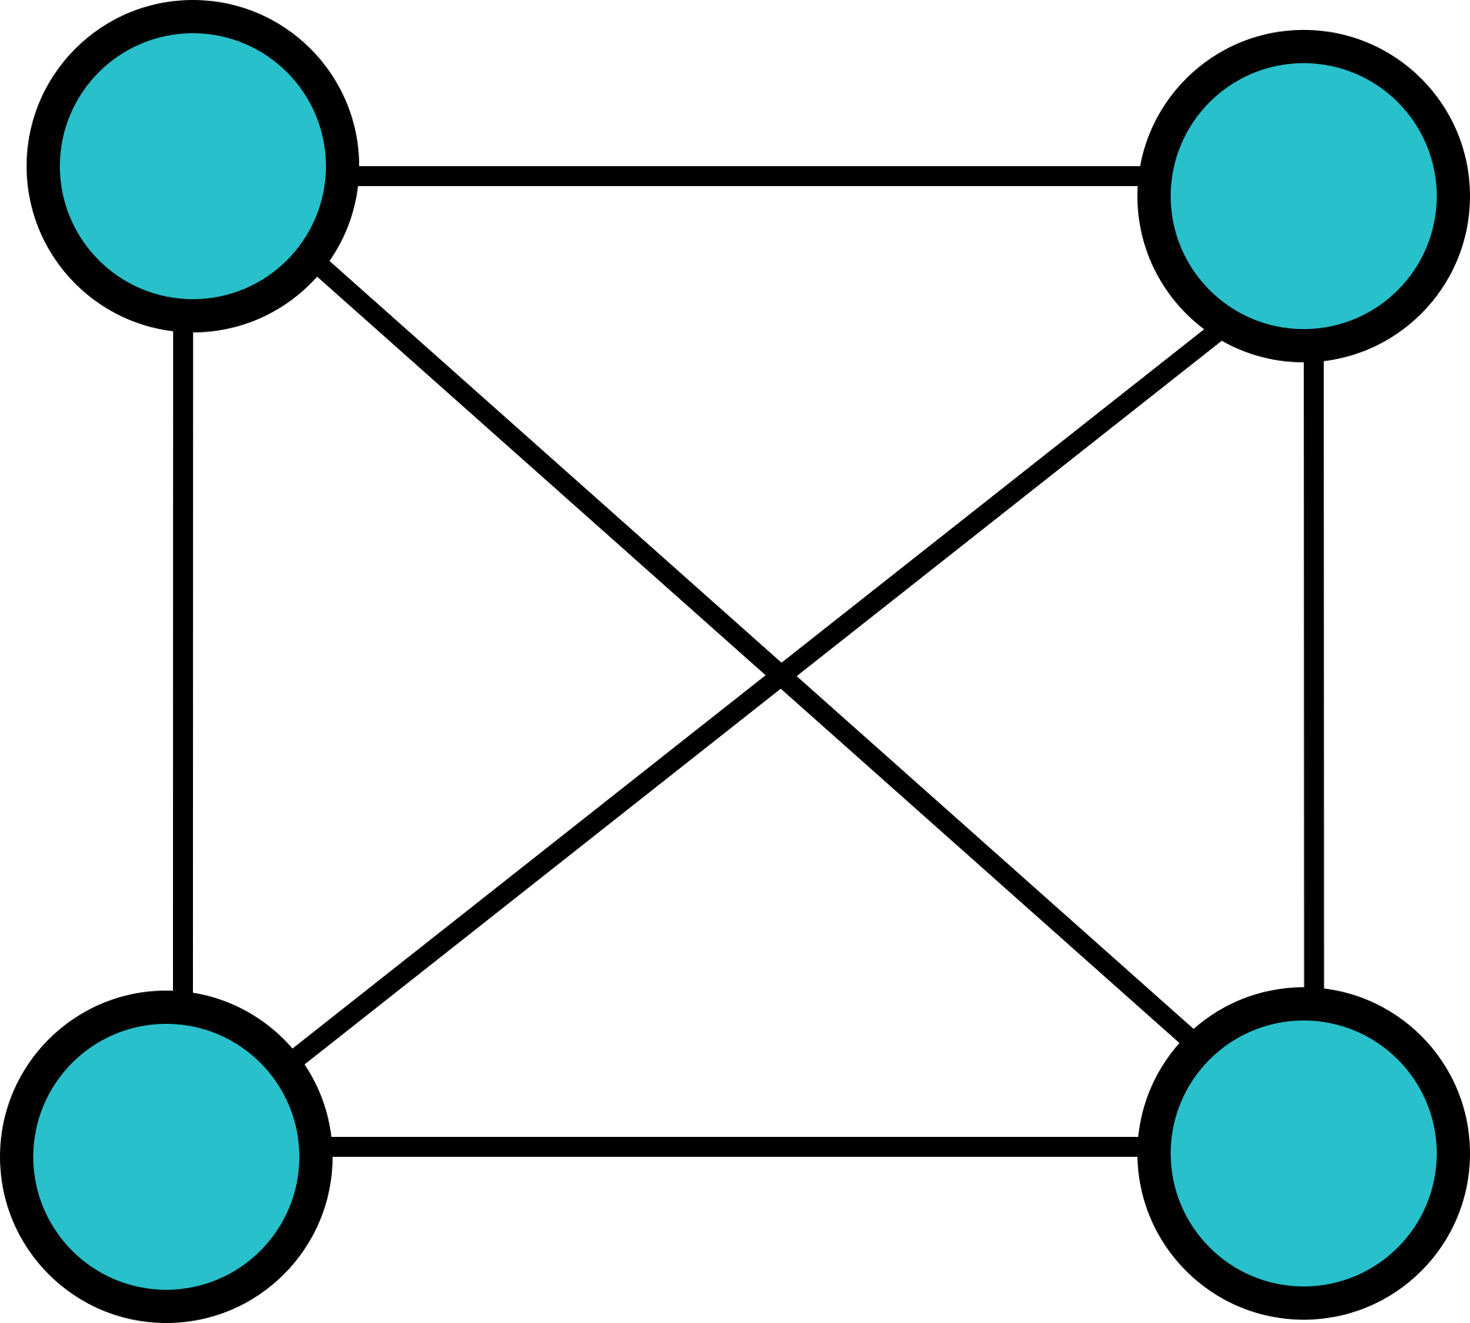
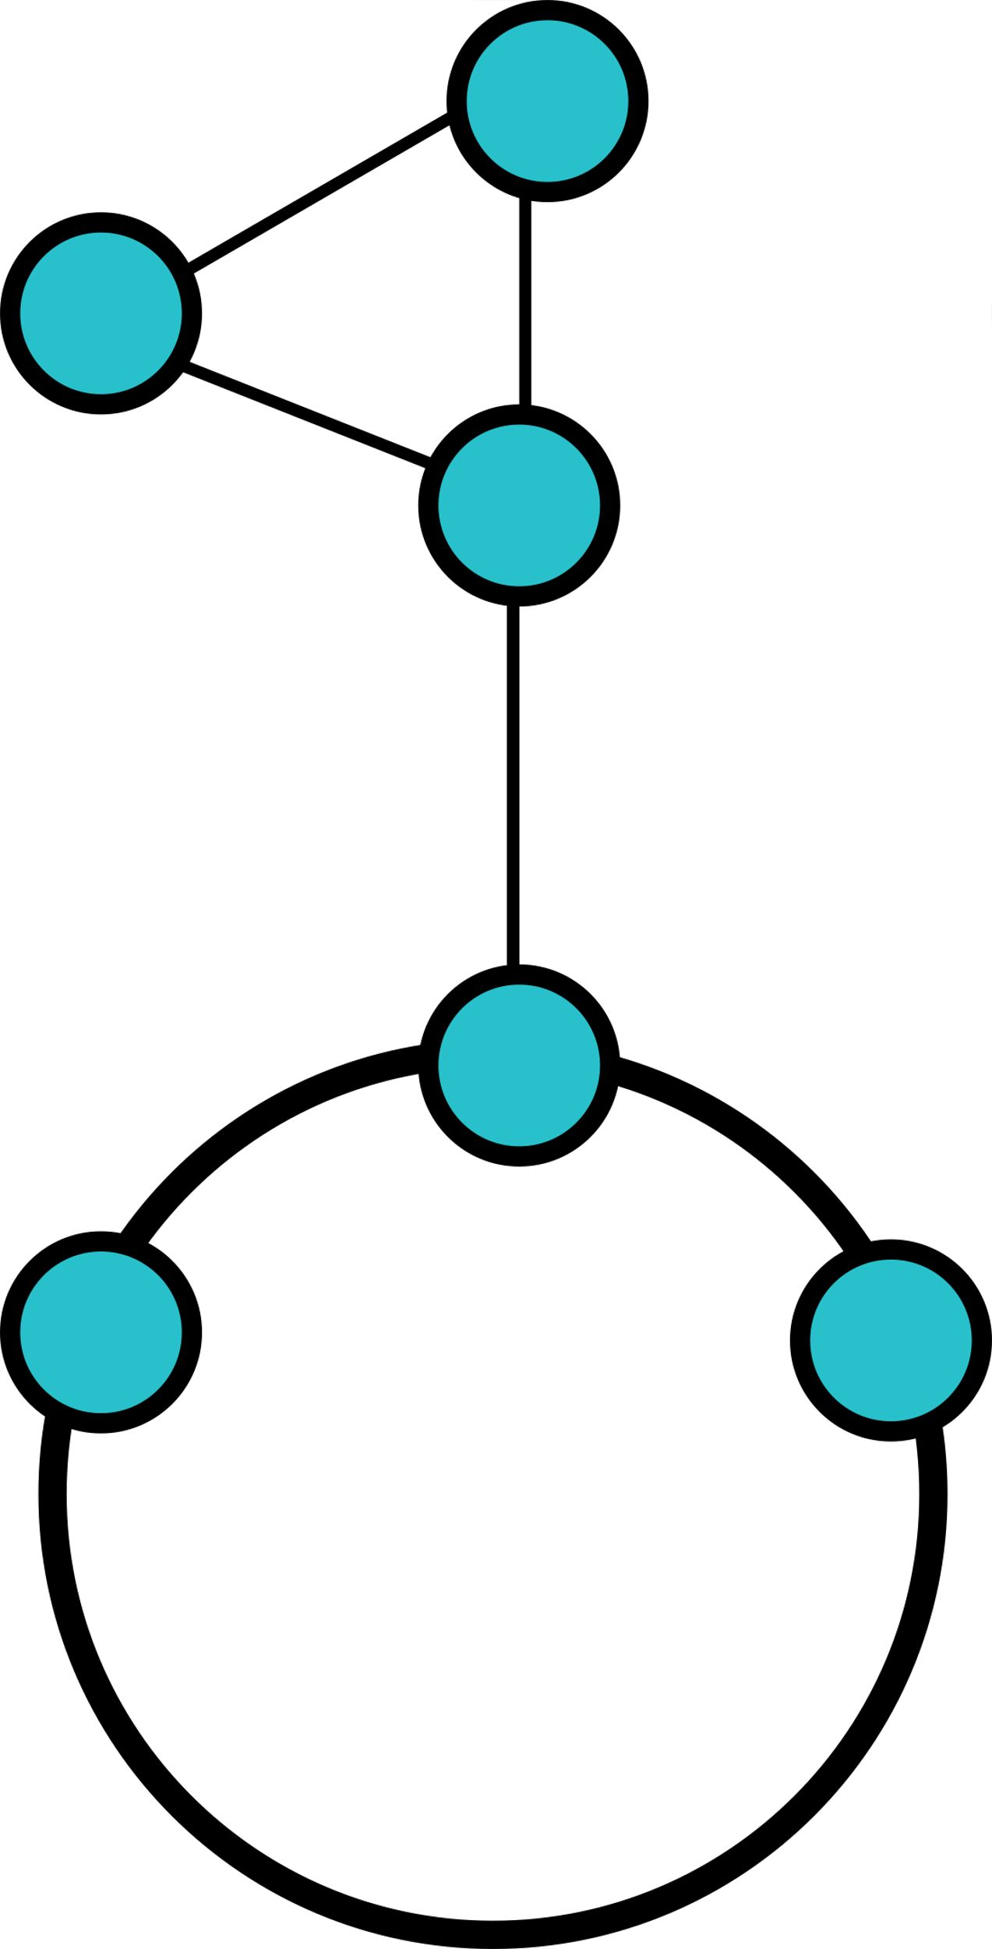
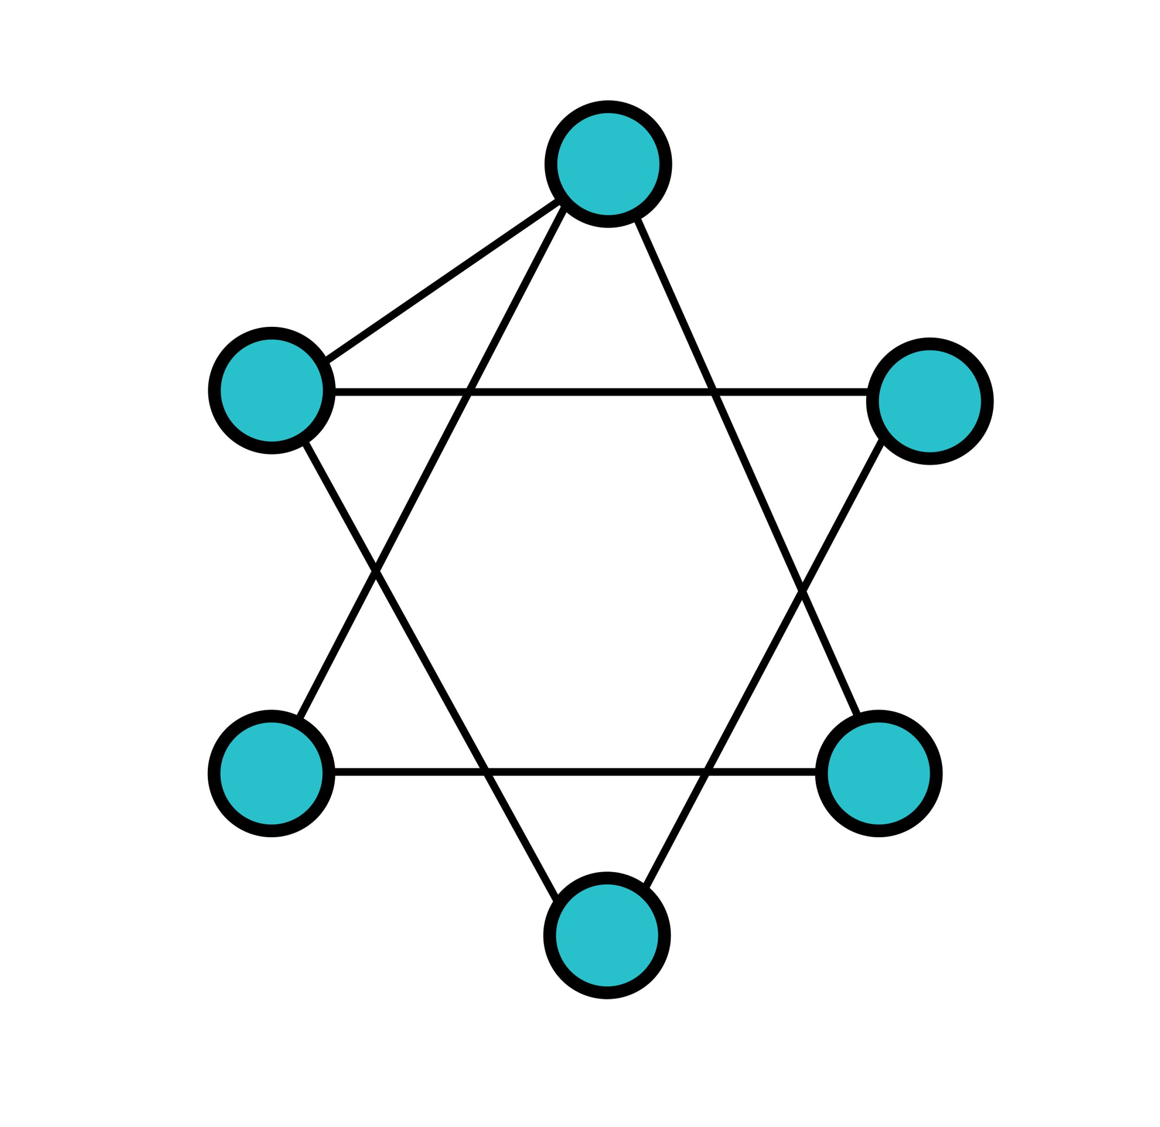
Isomorphism
Sometimes, it would be hard to see the isomorphic relation between graphs. For example, it’s simple to tell that these 2 graphs are not isomorphic.
However, it’s hard to tell that the following 2 graphs are isomorphic.

Slide 13
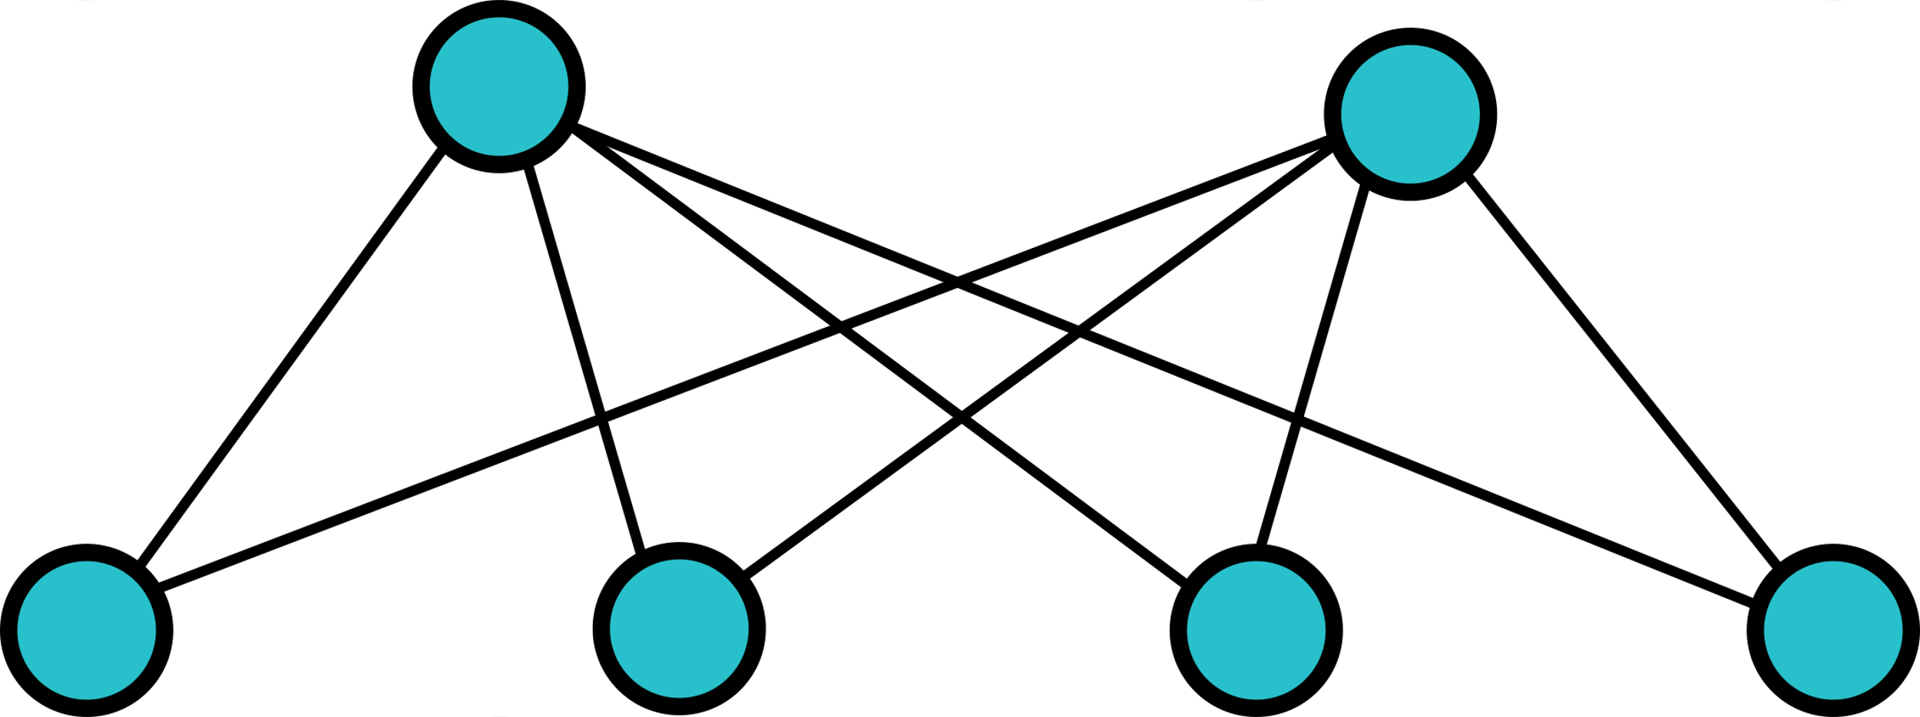
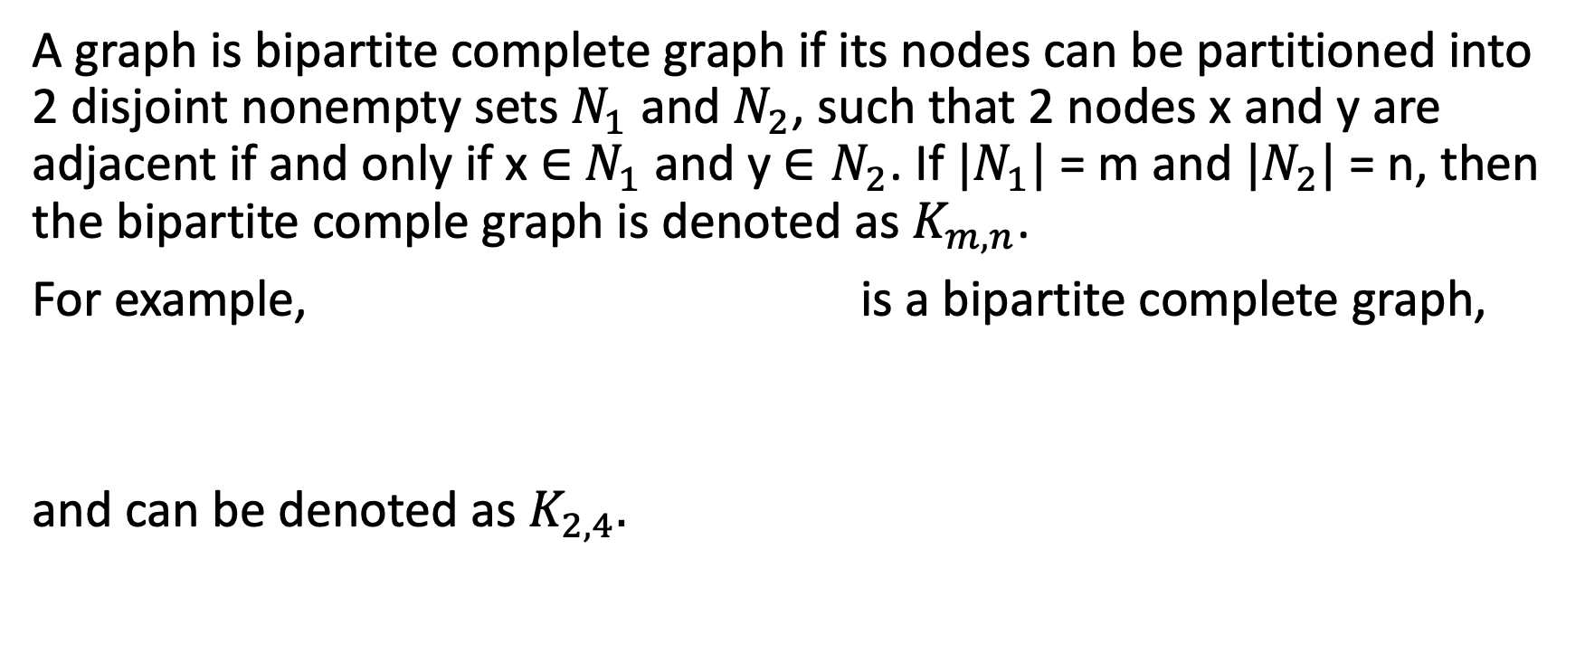
Bipartite Complete Graph
A graph is bipartite complete graph if its nodes can be partitioned into 2 disjoint nonempty sets $N_{1}$ and $N_{2}$, such that 2 nodes x and y are adjacent if and only if x $∈$ $N_{1}$ and y $∈N_{2}$. If ${|N}_{1}|$ = m and $|N_{2}|$ = n, then the bipartite comple graph is denoted as $K_{m, n}$.
For example, is a bipartite complete graph,
and can be denoted as $K_{2, 4}.$

Slide 14
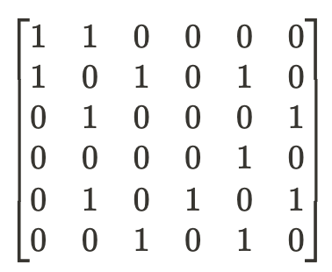
Adjacency Matrix
In mathematics and programming, we usually present a graph as an adjacency matrix; an adjacency matrix is a square matrix used to represent a finite graph. The elements of the matrix indicate whether pairs of vertices are adjacent or not in the graph.
For example, the adjacency matrix of the graph would be the matrix on the right, where the (i, j) element of the matrix indicates whether node i is adjacent to node j.
*. The applications and meaning of adjacency matrix will be taught in linear algebra.

Slide 15

6-2 Trees and Their Representation

Slide 16
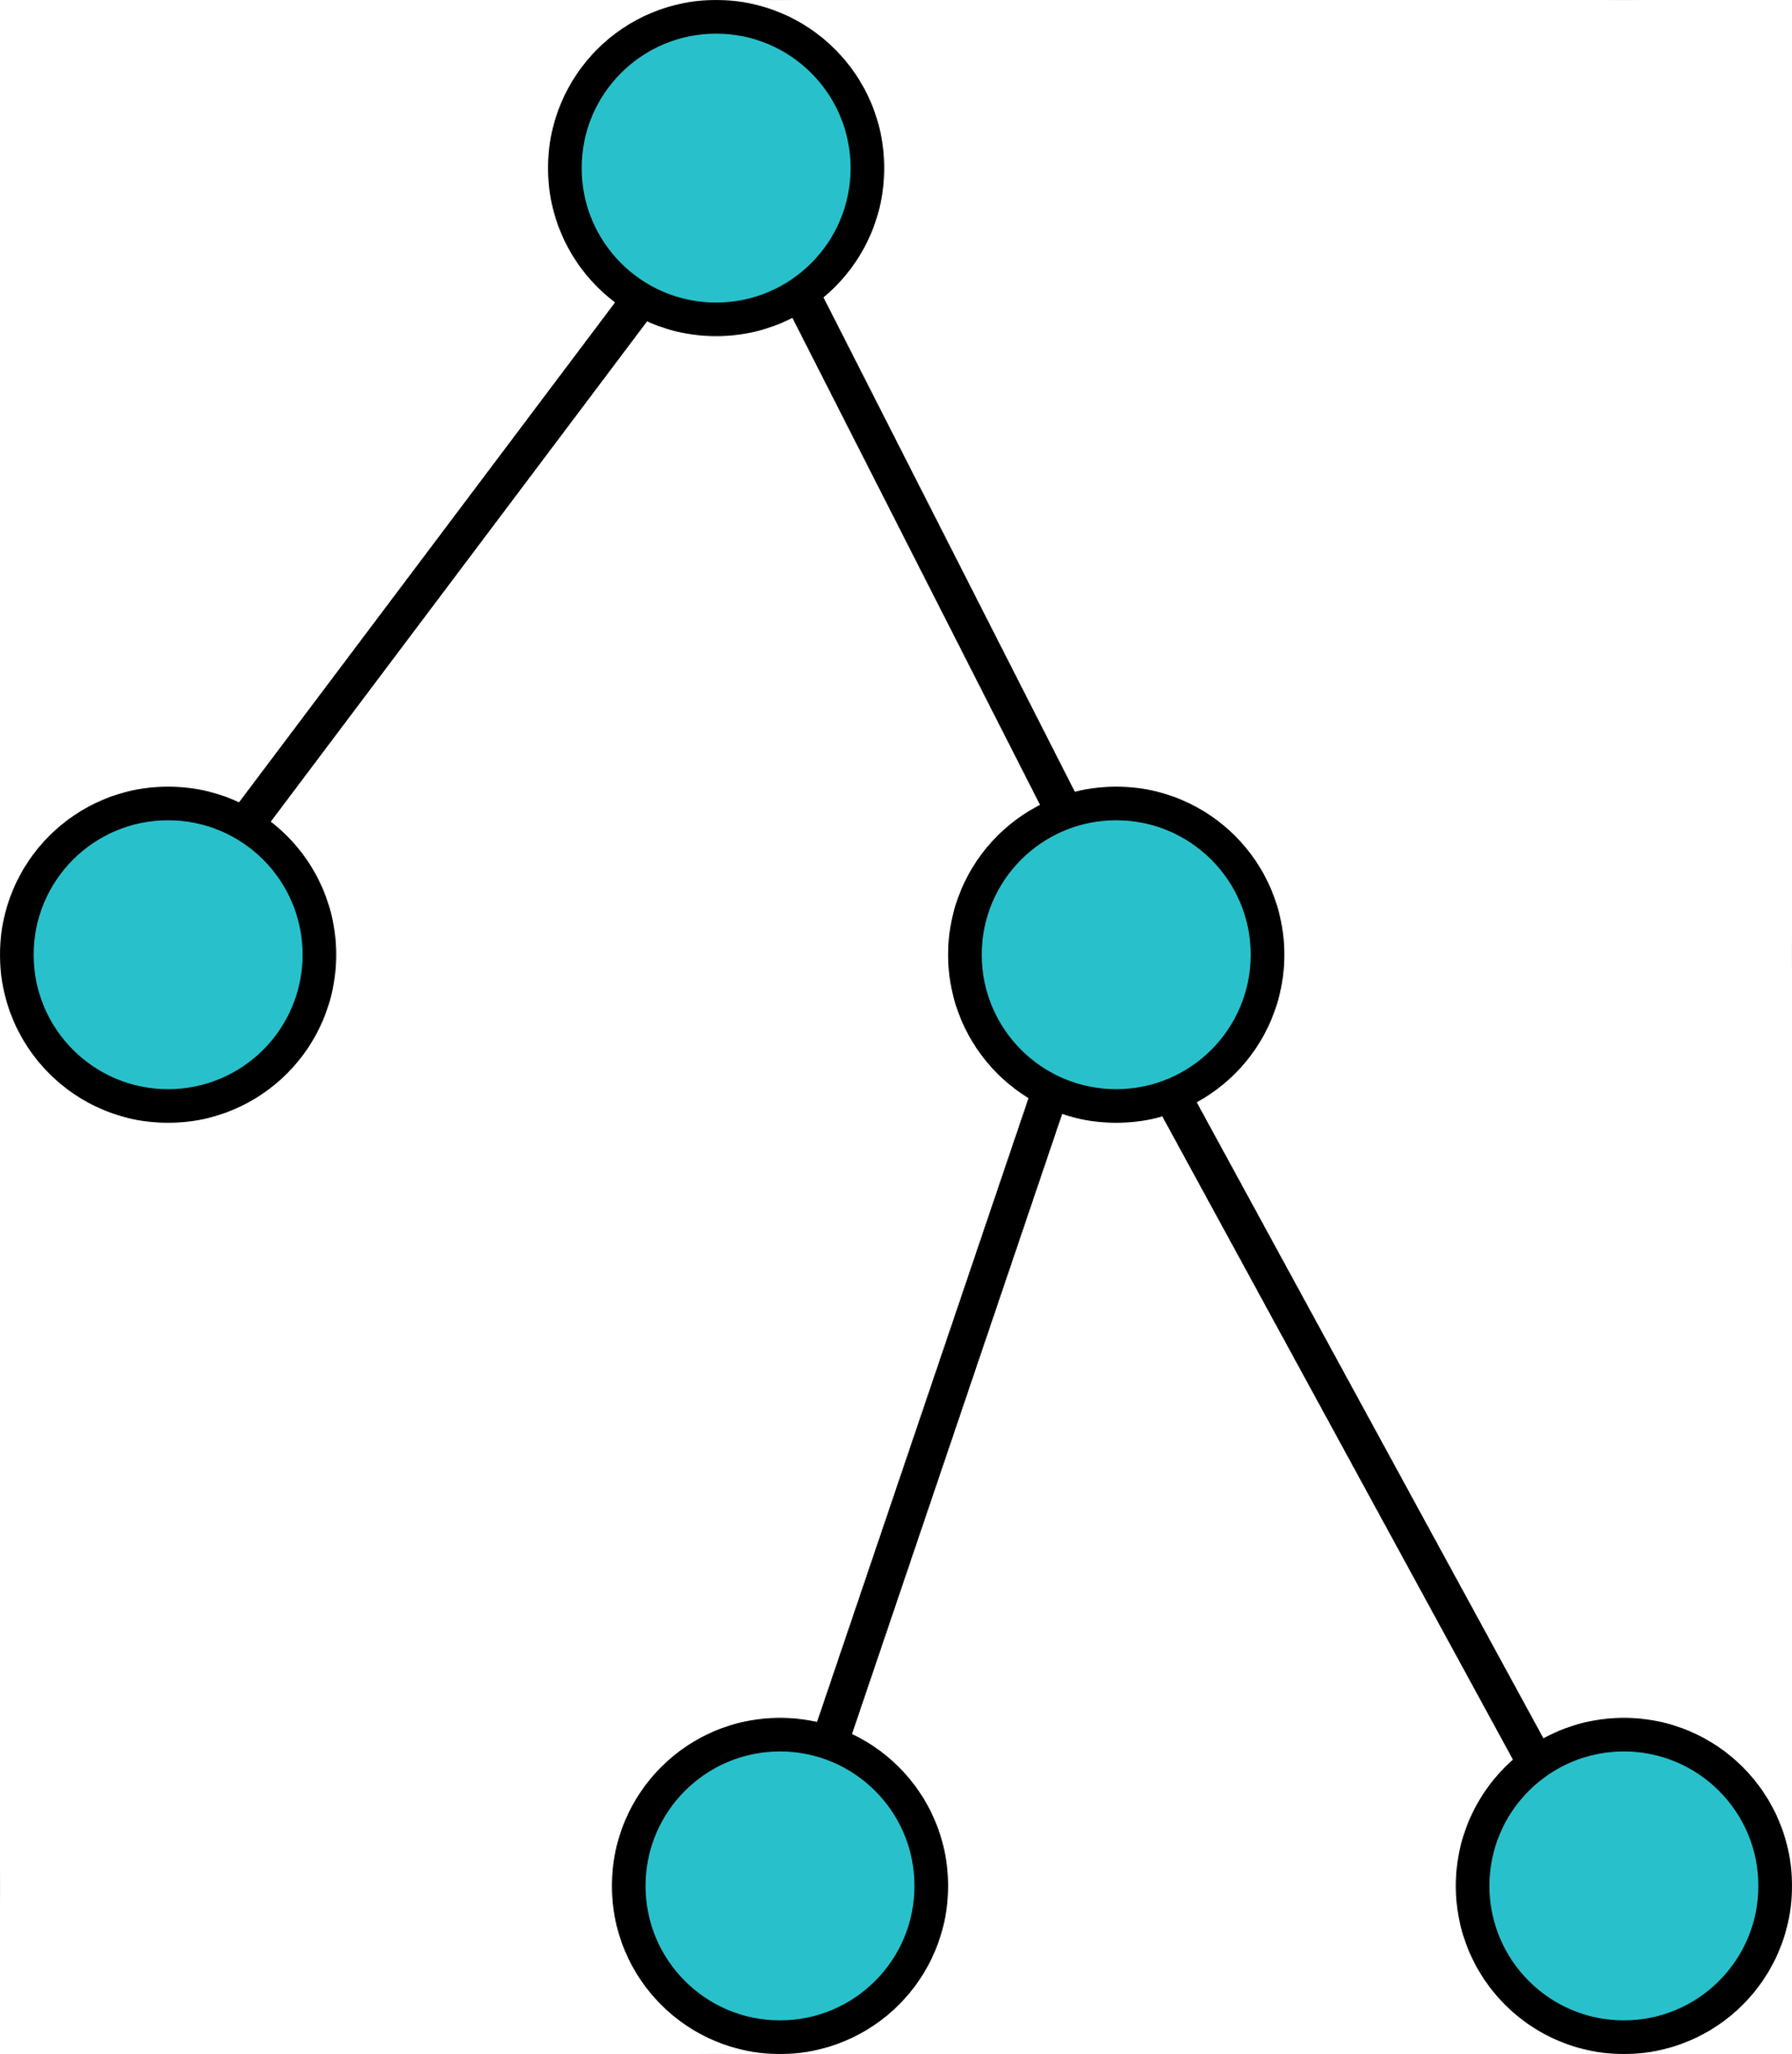

Tree
A tree is an acyclic, connected graph with one node designated as the root of the tree. For example, the top graph is a tree, but the bottom graph is not a tree.
A node that has a child is called the child's parent node. A node has at most one parent, but possibly many ancestor nodes, such as the parent's parent. Child nodes with the same parent are sibling nodes.
*. Most of the textbooks define that all descendants of the parent node is the child nodes of that parent node.

Slide 17
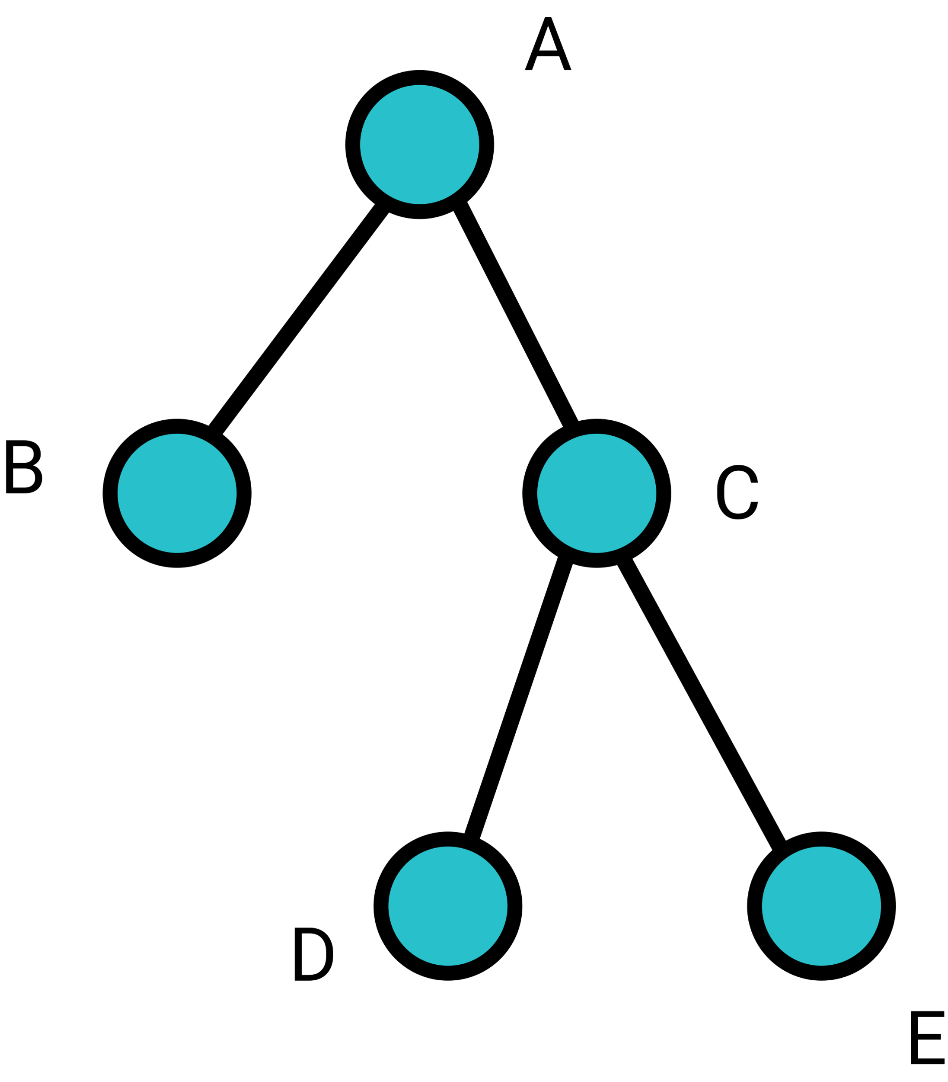
Terminology of Trees
Let’s learn some terminologies of tree.
Depth – the depth of a node is the length of the path from the root to the node.
Height – the height of a tree is the maximum depth of any node in the tree.
Leaf – a node without any child nodes is called a leaf.
Binary Tree – a tree that each node has at most 2 child nodes.
The depth of D is 2, and the depth of B is 1. The height of this tree is 2, and B, D, E are the leaf nodes. This tree is a binary tree, since each node has at most 2 child nodes.

Slide 18
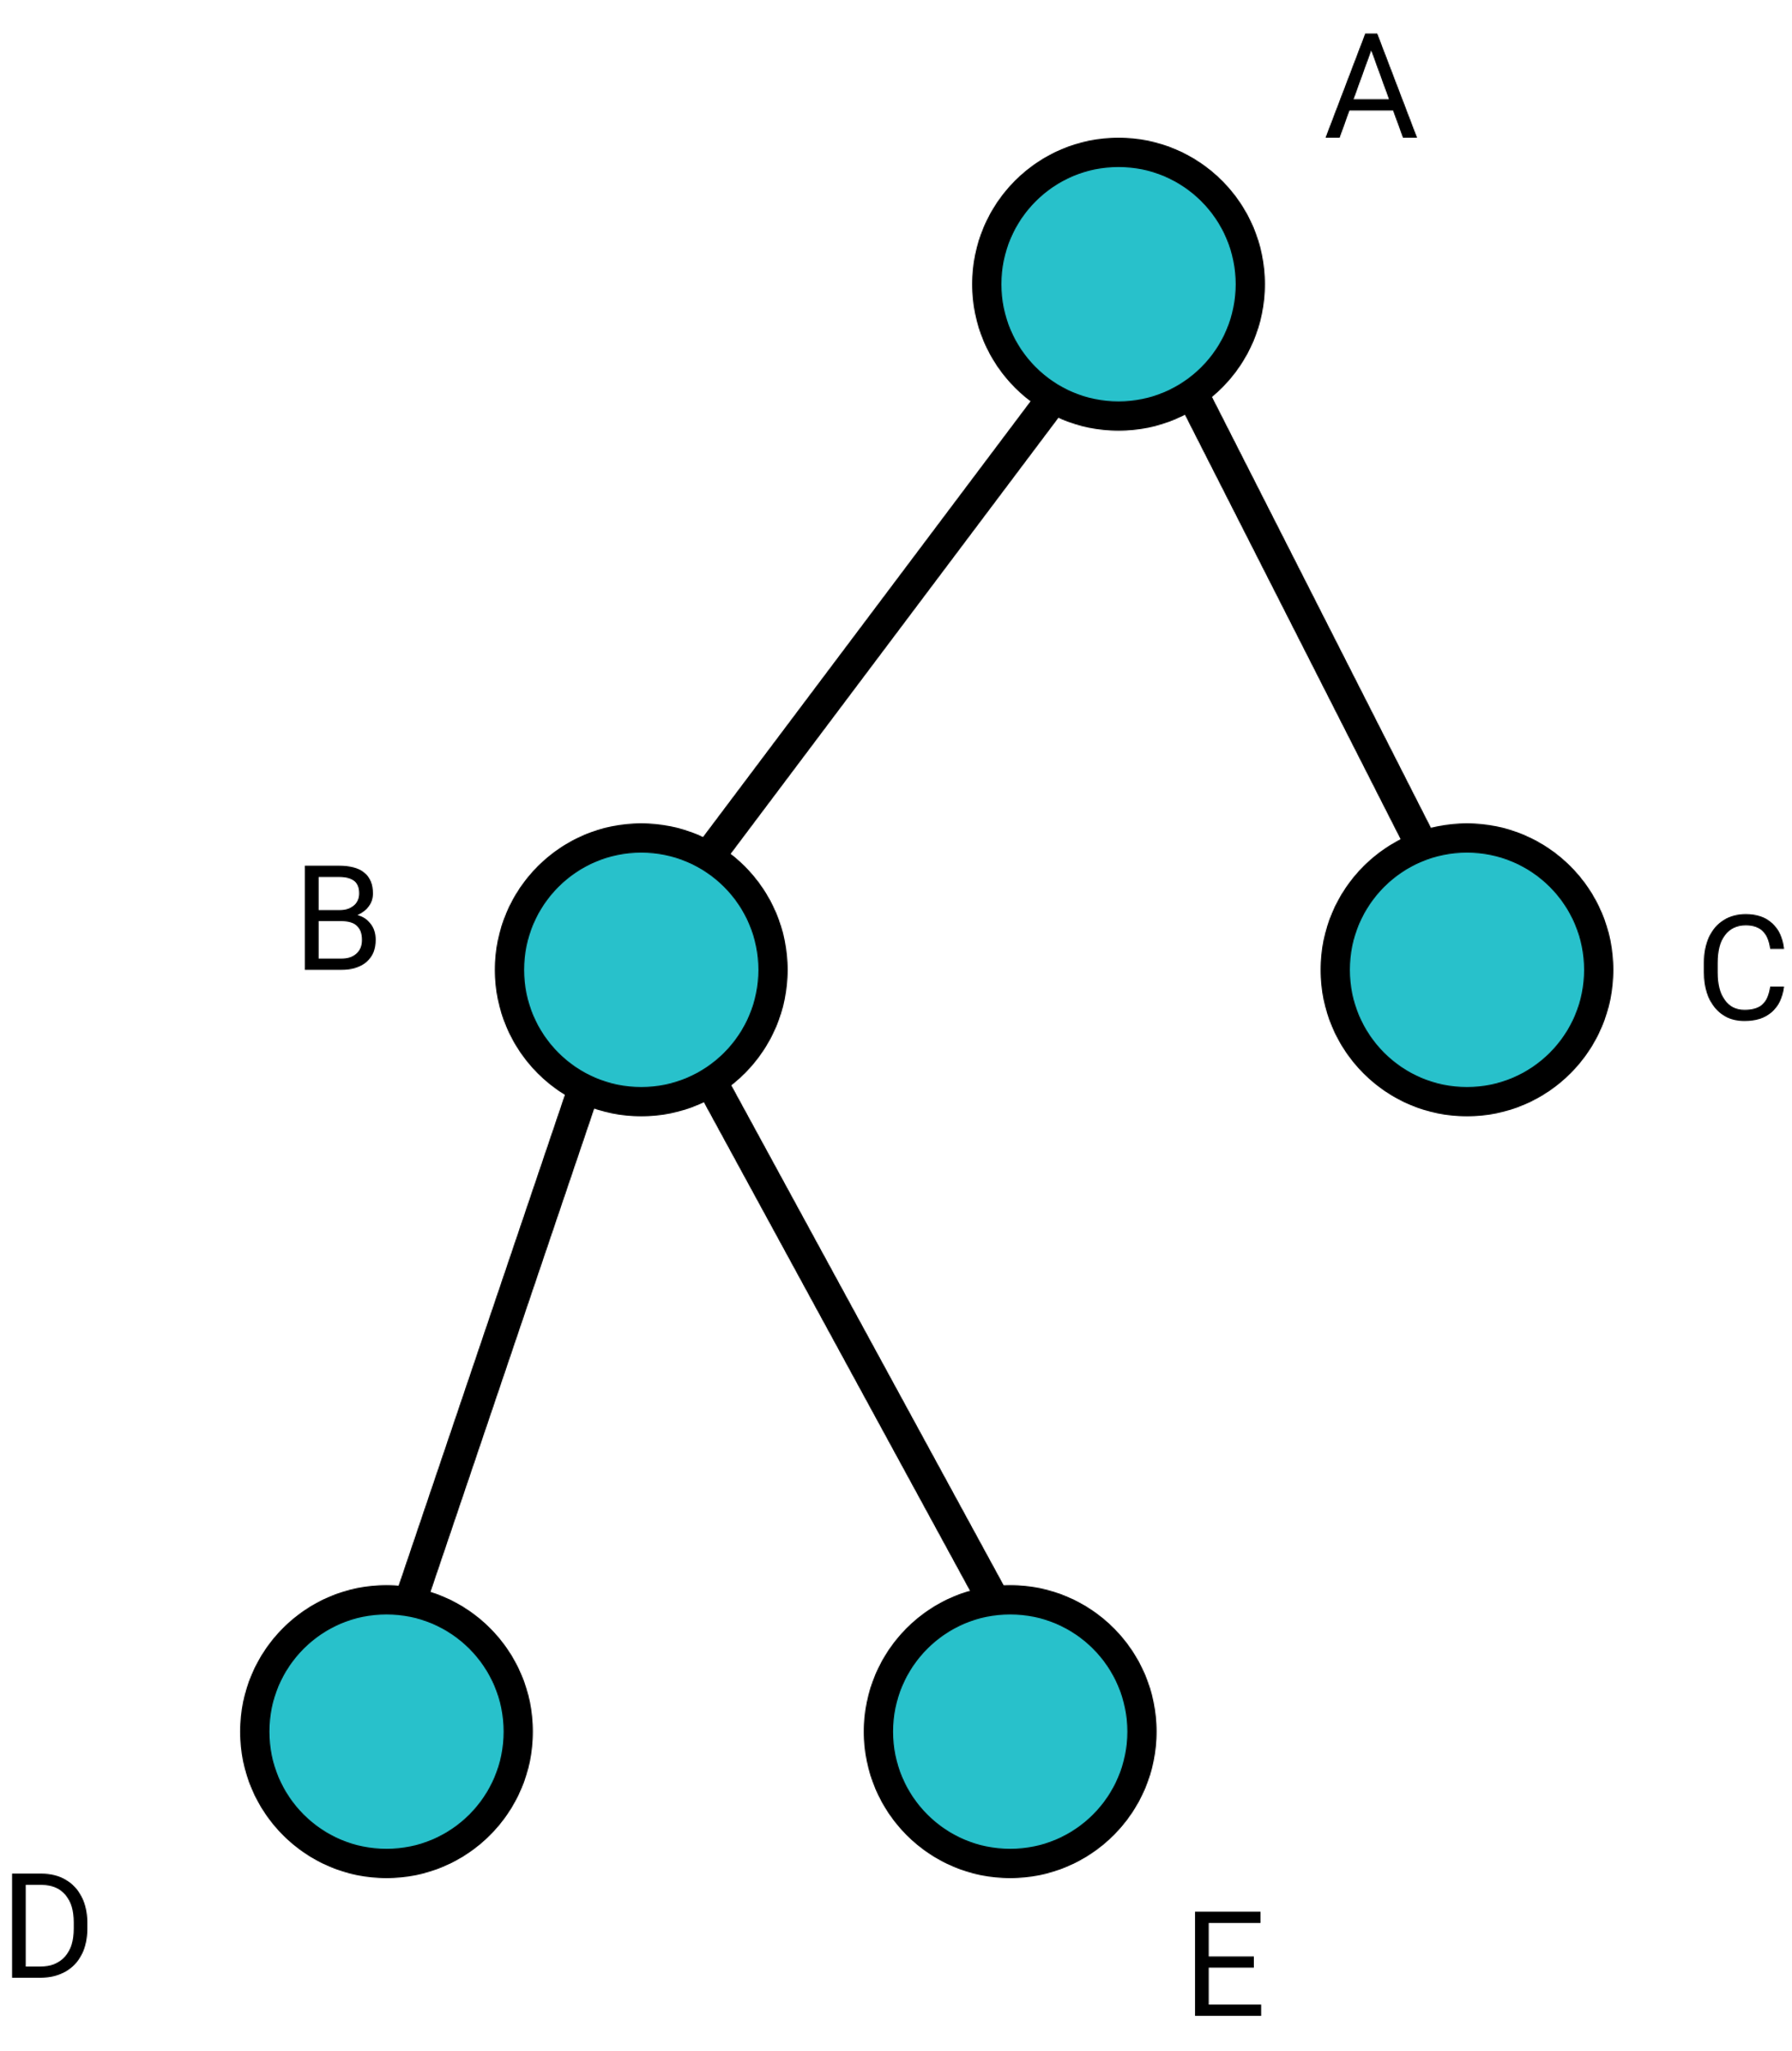
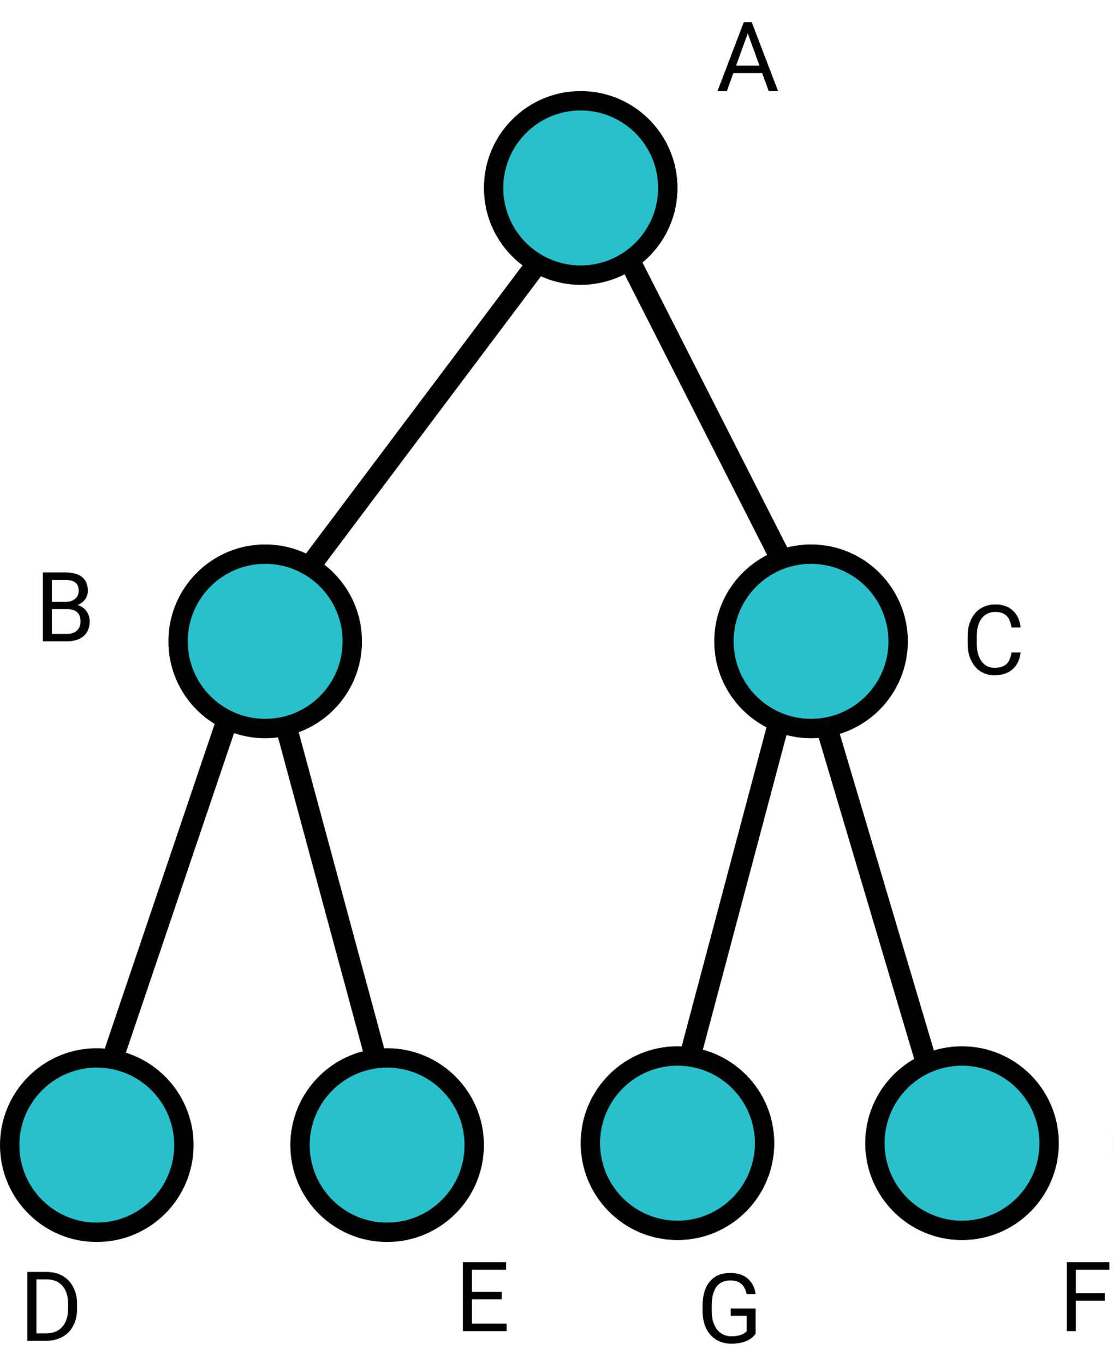
Terminology of Trees
Complete Binary Tree – a tree in which every level, except possibly the last, is completely filled, and all nodes are as far left as possible.
Full Binary Tree - a tree in which every node other than the leaves has two children.
For example, the left graph is a complete binary tree, and the right graph is a full binary tree.

Slide 19
Applications of Tree
There are tons of different applications of Tree in computer science, to name a few:
Abstract Syntax Tree (Used in compiler)
Document Object Model (Used in browers and JavaScript)
File System in Operating System (Used in PC)
Binary Search Tree (Used in database)
Decision Tree Based Learning (Used in Machine Learning)
Many others…

Slide 20
Tree Traversal Algorithms
Since tree is a common data structure, it would be helpful to have a systematic way to write out all values in the tree. There are way ways to do tree traversal:
Depth First (PreOrder, InOrder, PostOrder)
Breadth First
Now we will just learn the concept of tree traversals, since the actual coding part requires more skills in programming.

Slide 21
Breadth First Tree Traversal
Breadth-first search involves search through a tree one level at a time. We traverse through one entire level of children nodes first, before moving on to traverse through the grandchildren nodes.
For example, the breadth first tree traversal result of the tree on the right would be:
A, B, C, D, E, G, F

Slide 22
PreOrder Depth First Tree Traversal
In pre-order tree traversal, the algorithm processes the root, then recursively processes all subtrees.
A common way to understand pre-order is “root, left, right”.
For example, the pre-order tree traversal result of the tree on the right will be:
A, B, D, E, C, G, F

Slide 23
InOrder Depth First Tree Traversal
In in-order tree traversal, the algorithm recursively processes the left subtree, then processes the root, and finally recursively processes the right subtree.
A common way to understand in-order is “left, root, right”.
For example, the in-order tree traversal result of the tree on the right will be:
D, B, E, A, G, C, F

Slide 24
PostOrder Depth First Tree Traversal
In post-order tree traversal, the algorithm recursively processes the left subtree, then recursively processes the right subtree, and finally processes the root.
A common way to understand in-order is “left, right, root”.
For example, the post-order tree traversal result of the tree on the right will be:
D, E, B, G, F, C, A

Slide 25

6-4 Huffman Encoding

Slide 26
Character Encoding
A character encoding provides a key to unlock the code. It is a set of mappings between the bytes in the computer and the characters in the character set.
For example, the ASCII (American Standard Code for Information Interchange) is a very common encoding system. The following is a small portion of ASCII table:
Binary | Decimal | Hexadecimal | Character
0010 0001 | 33 | 21 | !
0100 0001 | 65 | 41 | A
0100 0010 | 66 | 42 | B

Slide 27
Character Encoding
Supposed we want to store a text file “A BAD BAG” in our computer; what would be the best way to do it? First, let’s encode the characters to the following bits:
A – 000, B – 001, D – 010, G – 011, white space - 100
since we only have 5 different characters to encode, we need to use 3 bits (by the multiplication rule, 2 bits can produce 4 different results, and 3 bits can produce 8 different results)
Then, the original text file would be:
000100001000010100001000011
We have totally 27 bits stored in the computer.

Slide 28
Character Encoding
Is there a better way to store this text file with less than 27 bits? When storing or transfering files, we want them to be as compact as possible.
In compression techniques, there are two types.
Lossy Compression
Lossless Compression
Lossy compression means that once the file has been compressed, we would never be able to get back the lost data. Lossless compression means that we can compress a file or image into small size, and restore the original file or image later without losing any data or information.
In this chapter, we will learn Huffman Encoding Algorithm, which is a lossless compression algorithm for text files.

Slide 29
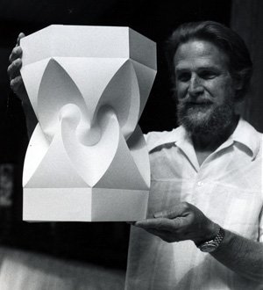
Huffman Encoding
Huffman encoding is an algorithm developed by David A. Huffman while he was a Sc.D. student at MIT, and published in the 1952 paper “A Method for the Construction of Minimum-Redundancy Codes.”
The principle of Huffman encoding is, if a letter appears many times in a file, then it sould be compressed into shorter bits. On the other hand, if a letter appears very less in a file, then it should be compressed into more bits.

Slide 30
Huffman Encoding
Here’s the Huffman Encoding algorithm:
Count the frequency of appearance for each characters in the text file.
Add the smallest 2 nodes together to form a new node. Keep repeating this step until we complete builing a binary tree. (This step requires a data structure called Min Heap, which will be taguth in algorithm and data structure.)
Use tree traversal algorithm to label the leaves. The left edge is labeled as 0, and the right edge is labeled as 1.

Slide 31
Huffman Encoding
Since the actual code writing for Huffman Encoding requires many skills in algorithm and data structure, we would just do Huffman Encoding by hands.
Supposed we want to encode “A BAD BAG”, then we first count the frequency of characters:
“A” 3 time, “B” 2 times, white space 2 times, “D” one time, “G” one time
Then, we build a tree by adding the smallest 2 nodes together to form a new node.

Slide 32
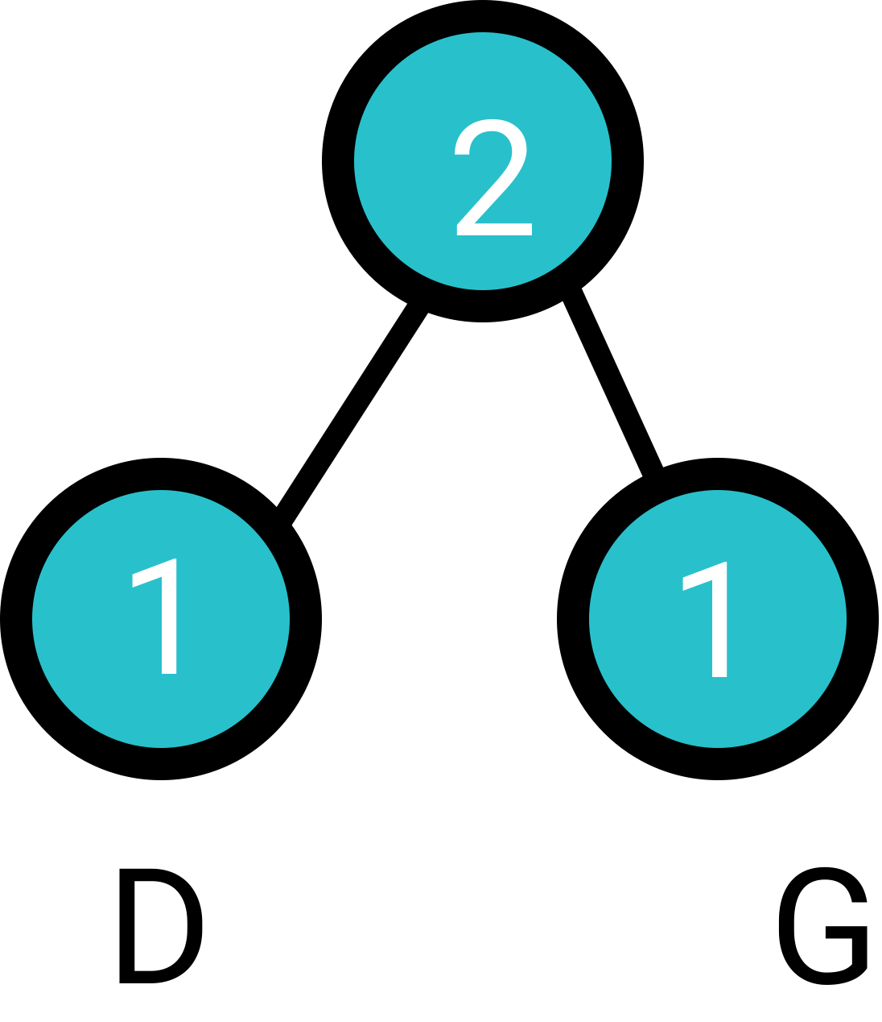
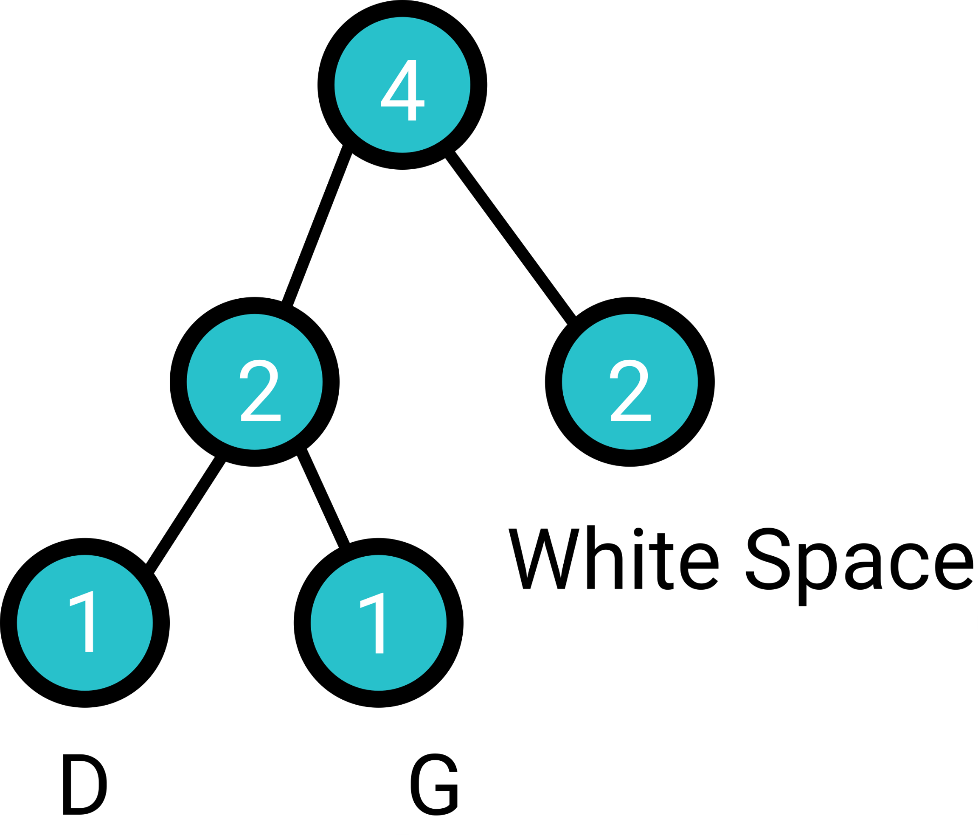
Huffman Encoding
D and G are the smallest, so we do: , now the smallest
nodes are the new formed node of value = 2 and white space; therefore, we do:

Slide 33
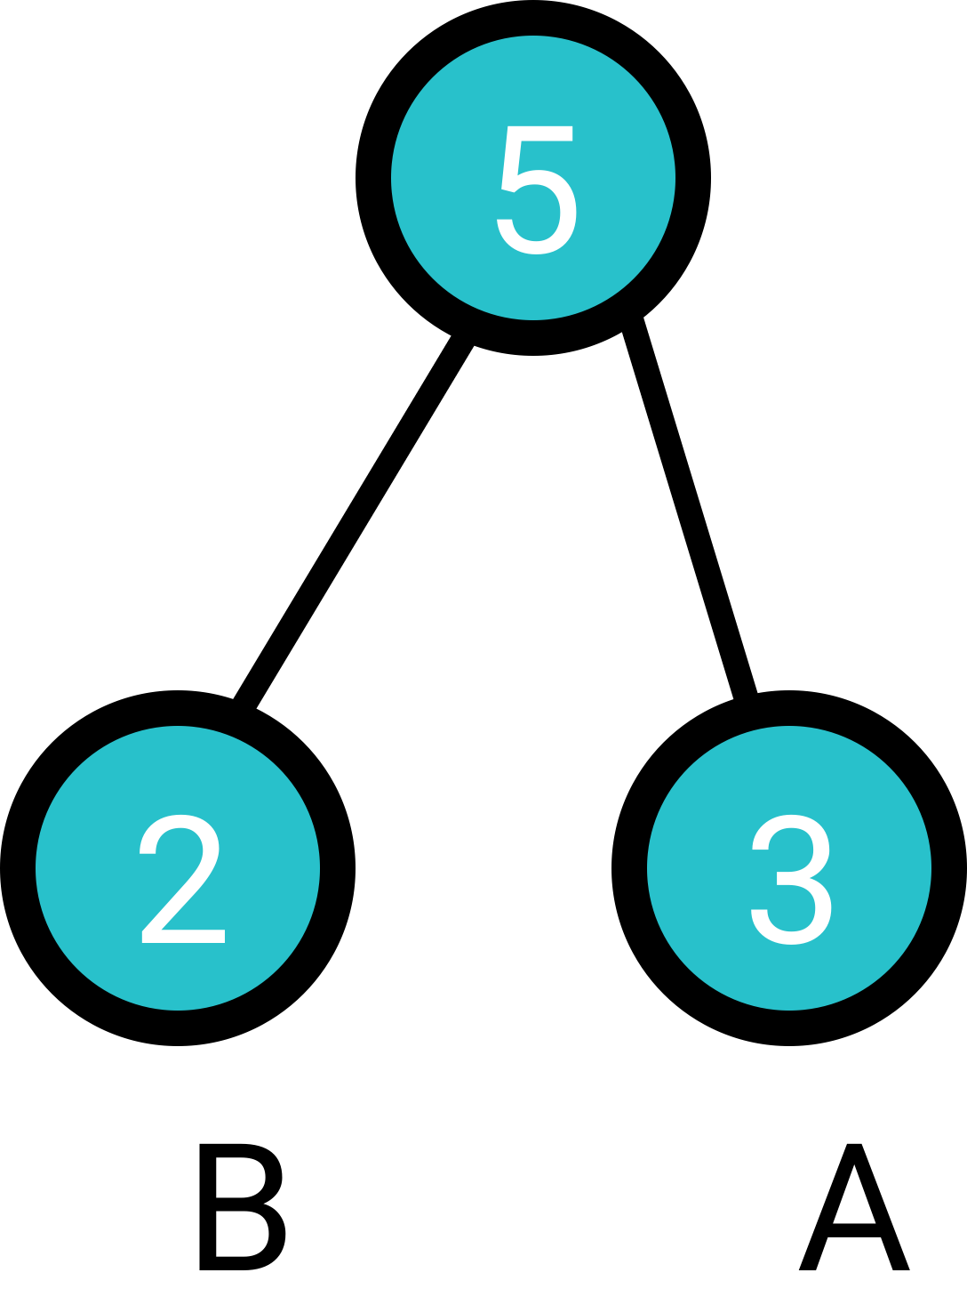
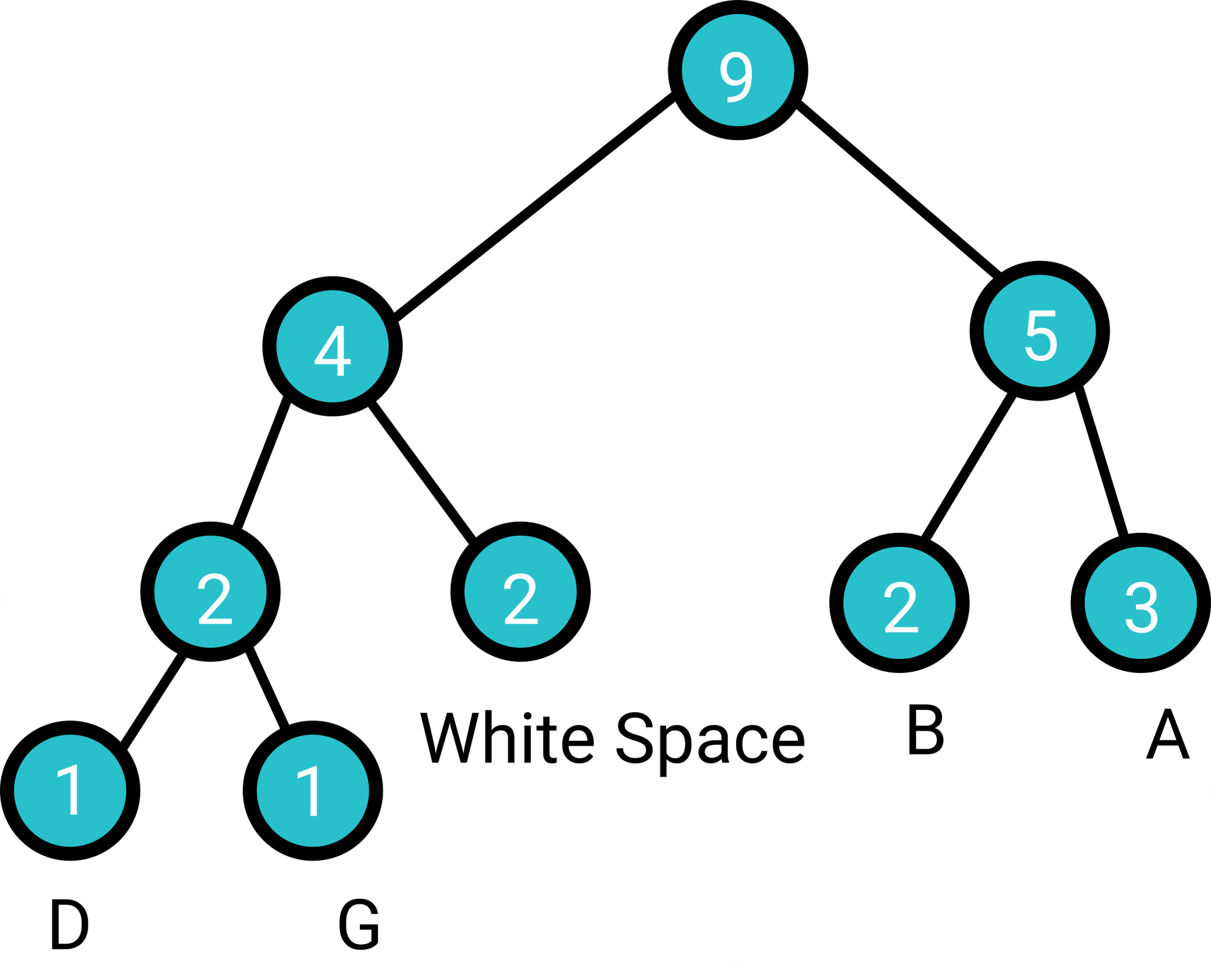
Huffman Encoding
Then, the smallest 2 nodes are B and A now; therefore, we do:
Now, the smallest 2 nodes are 4 and 5;
therefore, we do:
Now, the Huffman Tree is built.

Slide 34

Huffman Encoding
After the Huffman tree is built, we need to label the edges:
Then, the new encoding for each character will be:
A – 11, B – 10, White Space – 01, D – 000, G – 001

Slide 35
Huffman Encoding
Finally, we can encode “A BAD BAG” to be:
11011011000011011001
Totally 20 bits here. By using huffman encoding, the file size has dropped from 27bits to 20bits, which is reduced by 26%. Is it huge? Not really. If we are working with files that has millions of characters, then it would reduce the file size by usually 40-60%.
How do we restore the bits into the original characters? We would check bit by bit. For example, 1 is meaningless, so we would check 11; then, we find that 11 is character A. Then, we continue to check bit 0, which is meaningless, then we check 01, and we find that 01 is white space. Keep repeating the process until we get “A BAD BAG”

